Slide 1
An NSS Audio-Visual
Library Presentation
Prince of Wales Island Expedition
Bob Klinger/Glacier Grotto 1991
S622 54 Slides 9/2/2021
Notes:
The National Speleological Society presents the following program by Bob Klinger about caving on Prince of Wales Island, Alaska, which was recorded in July 1991 at the Society’s convention in Cobleskill, New York.

Slide 2
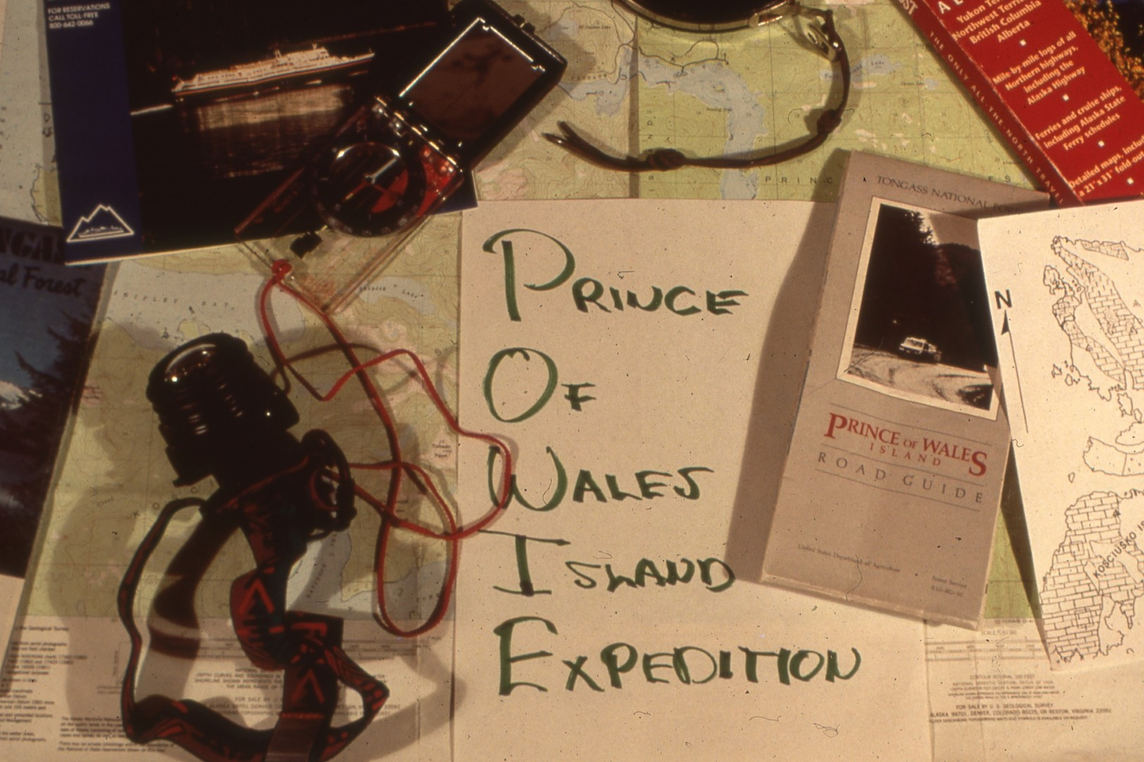
Notes:
The talk that I am going to be giving this morning is going to be a general overview of what we’ve been doing up in Alaska. I’m going to talk a little about Alaska itself, a little bit about where are and where we’re going. I’m going to tell you how to get there if you want to get up there, some of the problems we have, a little about the clothes and equipment that’s desirable to have, and generally some of the things that are nice to know before you go. Prince of Wales Island expeditions actually began in 1987 when a couple of cavers, or a family, Kevin and Carlene Allred, originally of Utah, homesteaded in Haines, Alaska and decided that it was time for them to get back to caving. They’d heard of caves and limestone on Prince of Wales Island, southern part of southeast Alaska. There had been a lot of logging going on, starting in 1950, and they’ve pretty well raped the northern part of the island. They got themselves, their car, and their three kids on a boat, headed down the inland passage, landed on Prince of Wales Island, drove north, and found caves.

Slide 3
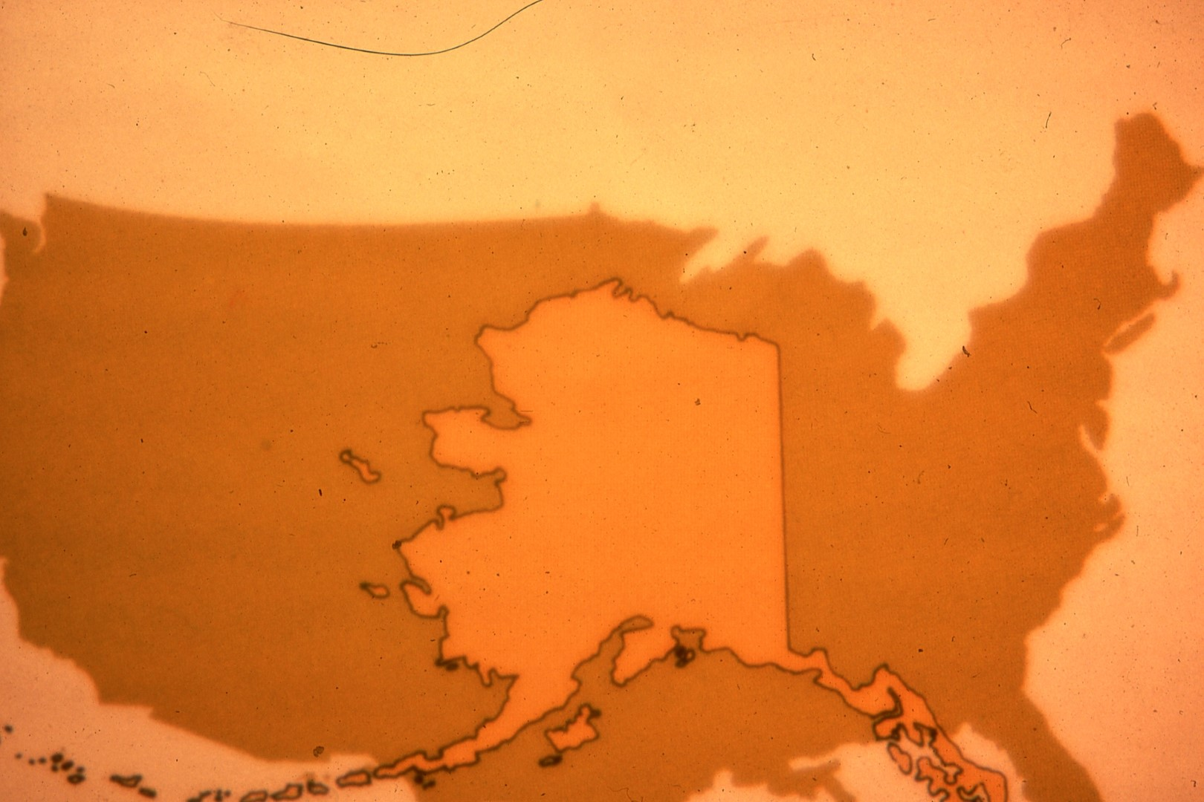
Notes:
They reported those caves to the rest of the grotto. Glacier Grotto covers the entire state of Alaska. And the next year there were about a dozen of us who had joined them on the island and have been since.

Slide 4
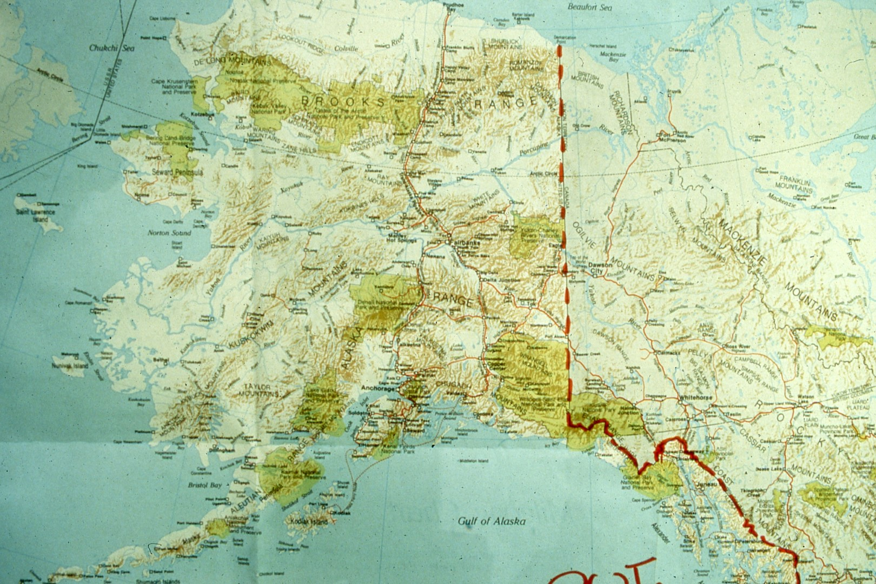
Notes:
Now where is Prince of Wales Island? Look at this map of Alaska and follow the coast southeast as far as you can go.

Slide 5
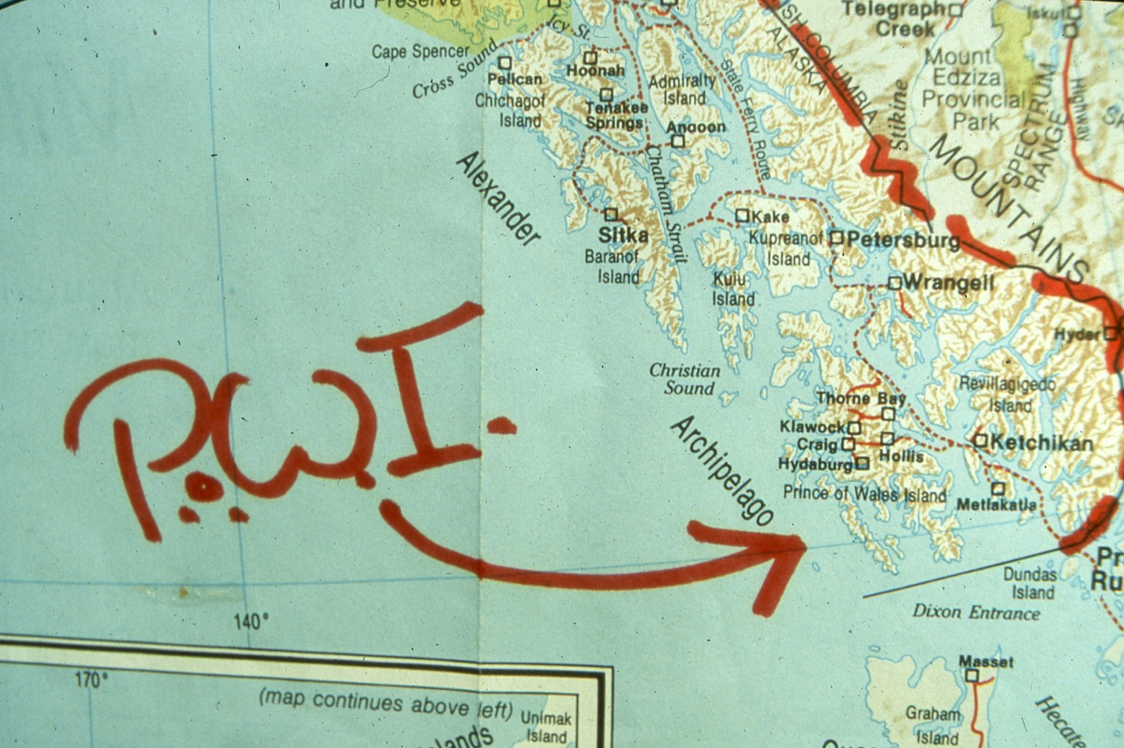
Notes:
Prince of Wales is the southernmost island in Alaska. Closer view will show you that the island is the largest island in the archipelago chain, the Alexander Archipelago. The island itself is about 2200 square miles with about 990 miles of coastline. There are a lot of small islands around it. You’re gonna get there, the easiest way for people from back here is to fly. You can fly directly to Ketchikan, you could fly to Seattle or Prince Rupert and take the inland passage up on the marine highway, then would catch a ferry and go on over to the island.

Slide 6
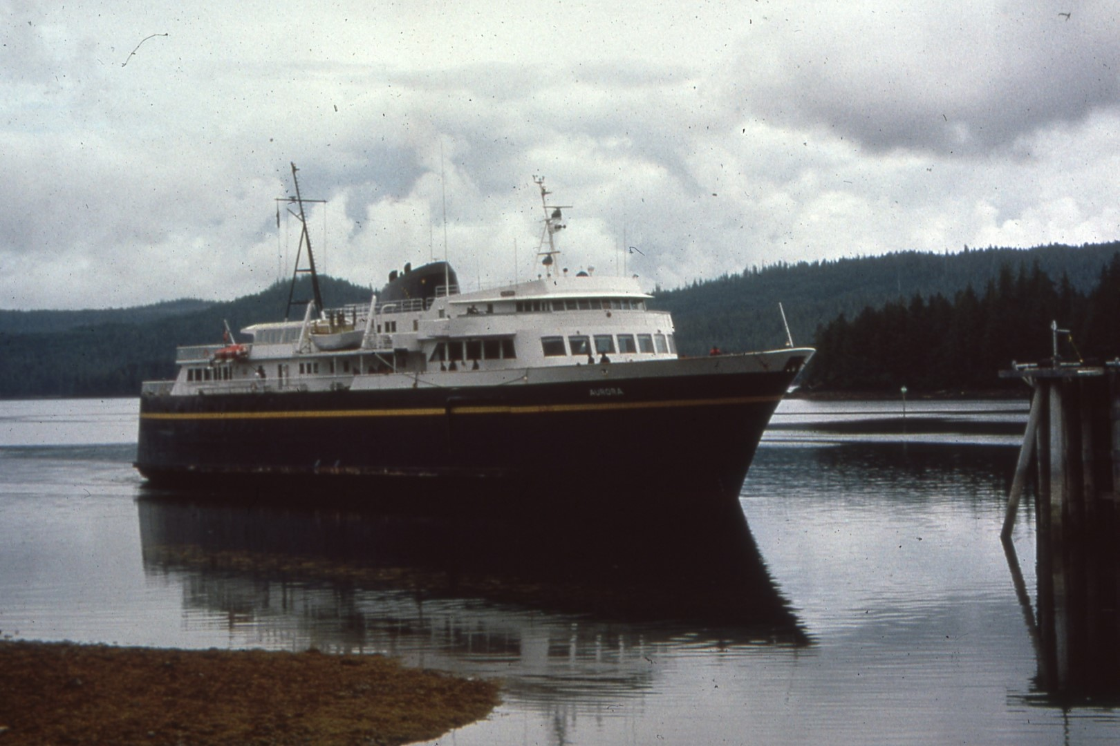
Notes:
If you’re gonna take your car up there, you’re gonna have to take the inland ferry passenger service. I drive from a couple hundred miles of Seattle, I’ll drive 1100 miles to Prince Rupert, load my car on there, and go on across to the island and then drive north to get up there.

Slide 7
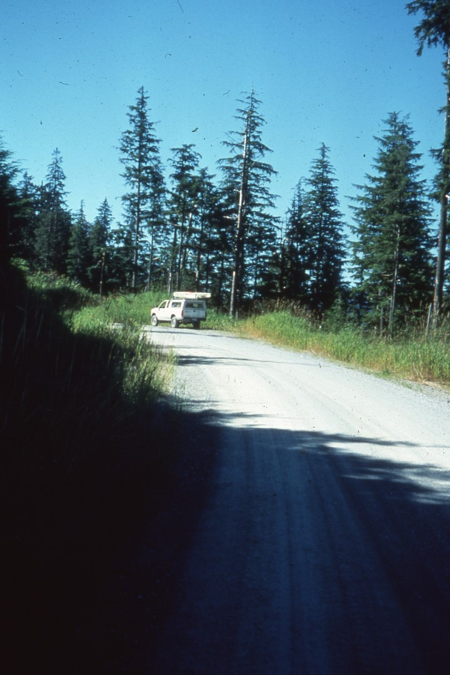
Notes:
The roads are gravel roads. You need, let me put it this way, it helps to have 6-ply tires. I had some fairly good tires and I tore one up last year. In driving the island there are rental cars, a couple that can be rented on the island. You can rent some Rent-a-Wrecks in Ketchikan, put them on the ferry, and bring them across. Some people will fly on in. We had one couple that flew in, landed, and kayaked up into the work camp.

Slide 8
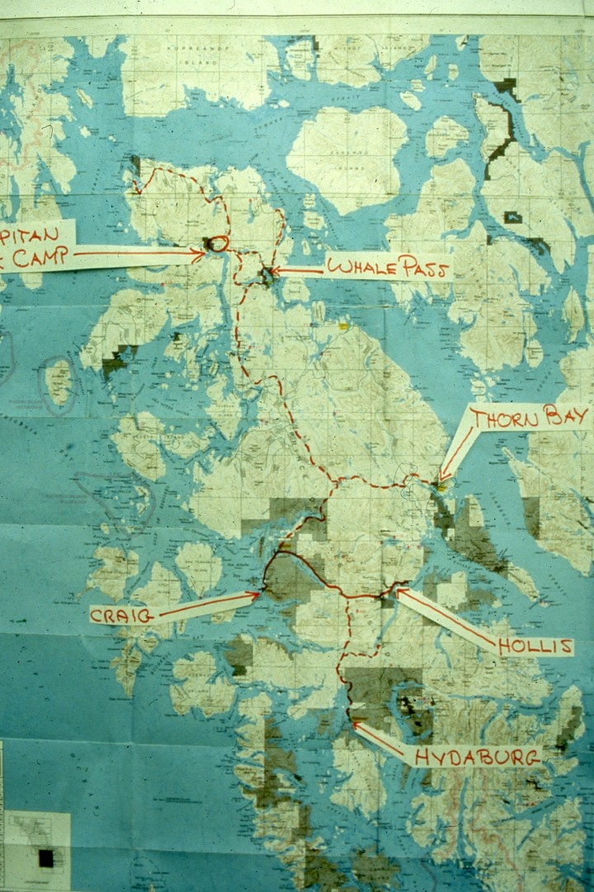
Notes:
The island itself has some key features. If you come by boat, you’re going to land at Hollis, located here. The only paved roads on the island are going across the island to the town of Craig and there is the town of Klawock, which is an Indian village, just above it. You can find most facilities there, from NAPA parts for your car, good grocery store, pretty much what you need in case of emergency. Because of the hassle you get from both Canadian and US Customs, when I drive up I buy my fresh food and vegetables in the particular country where I am. Once I get to Craig, I’ll stock up with fruit and vegetables and go north. If you’re up there to sightsee, the town of Hydaburg has some interesting totems, south of there.
The main route up is up the gravel roads to the north. The town of Thorne Bay, formerly a logging camp, and still has a logging facility associated there, is now a community with private property, stores, and it’s the headquarters for the Thorne Bay Ranger District, that controls the upper part of the island for the US Forest Service. As you drive on north, you’ll go to the area up here of the El Capitan work camp, that’s a US Forest Service work camp, and I’ll talk more about that in a minute. To the east is a community of 27 people, plus or minus, year-round residents, of Whale Pass. You can buy gas there, they have a tank and a pump. They’ve got a small grocery store where you can get ice. You can get cookies, sometimes bread, and maybe a few cans of something., but don’t count on much from that particular store. There is a telephone there now, so you can call out, via commercial telephone.

Slide 9
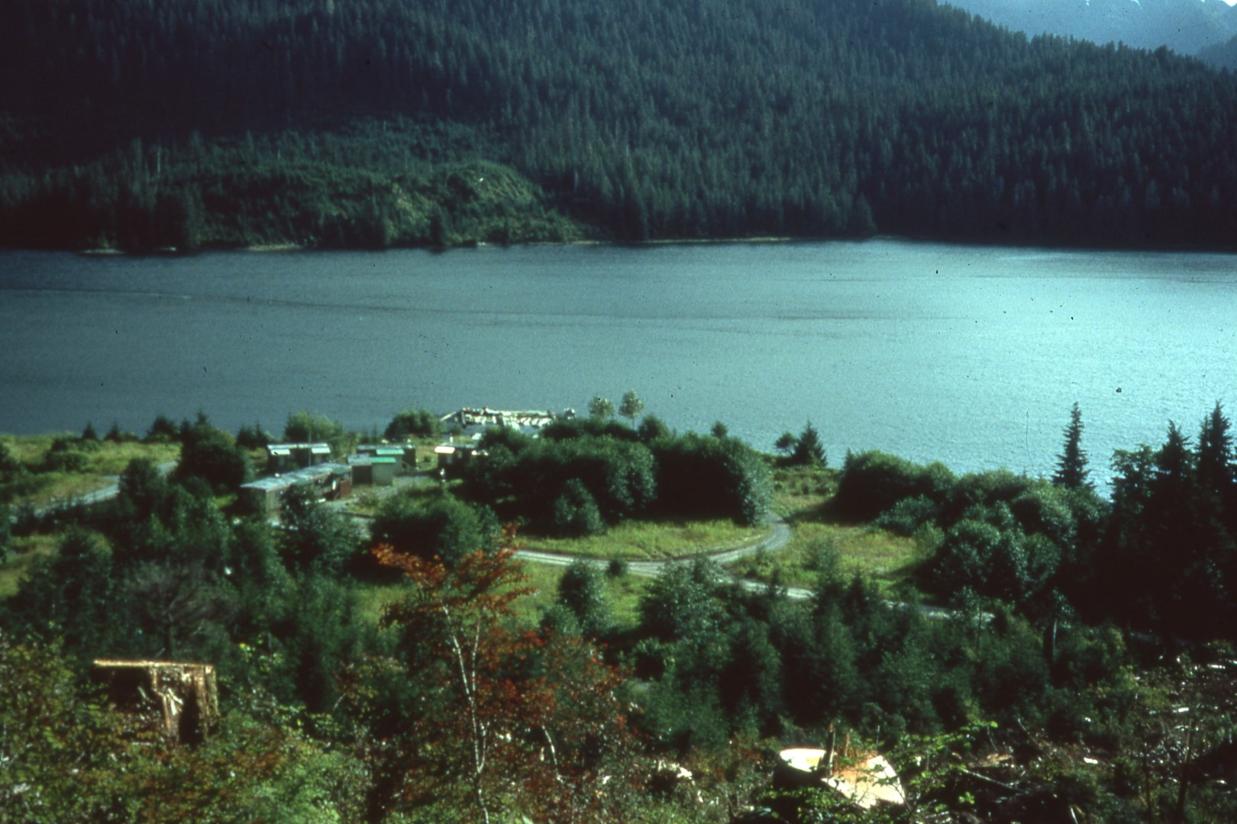
Notes:
The El Capitan work camp is shown on El Capitan passage. It has a series of temporary-type buildings that are used in the summer months only by the Forest Service. The wildlife geologist, the timber cruisers, the people that are marking their boundaries for timber sales, and so forth, work out of there during the week then bug out for Ketchikan or other points over the weekend. The Forest Service gave us, and I’m talking about Glacier Grotto, the area to the right that is open.

Slide 10
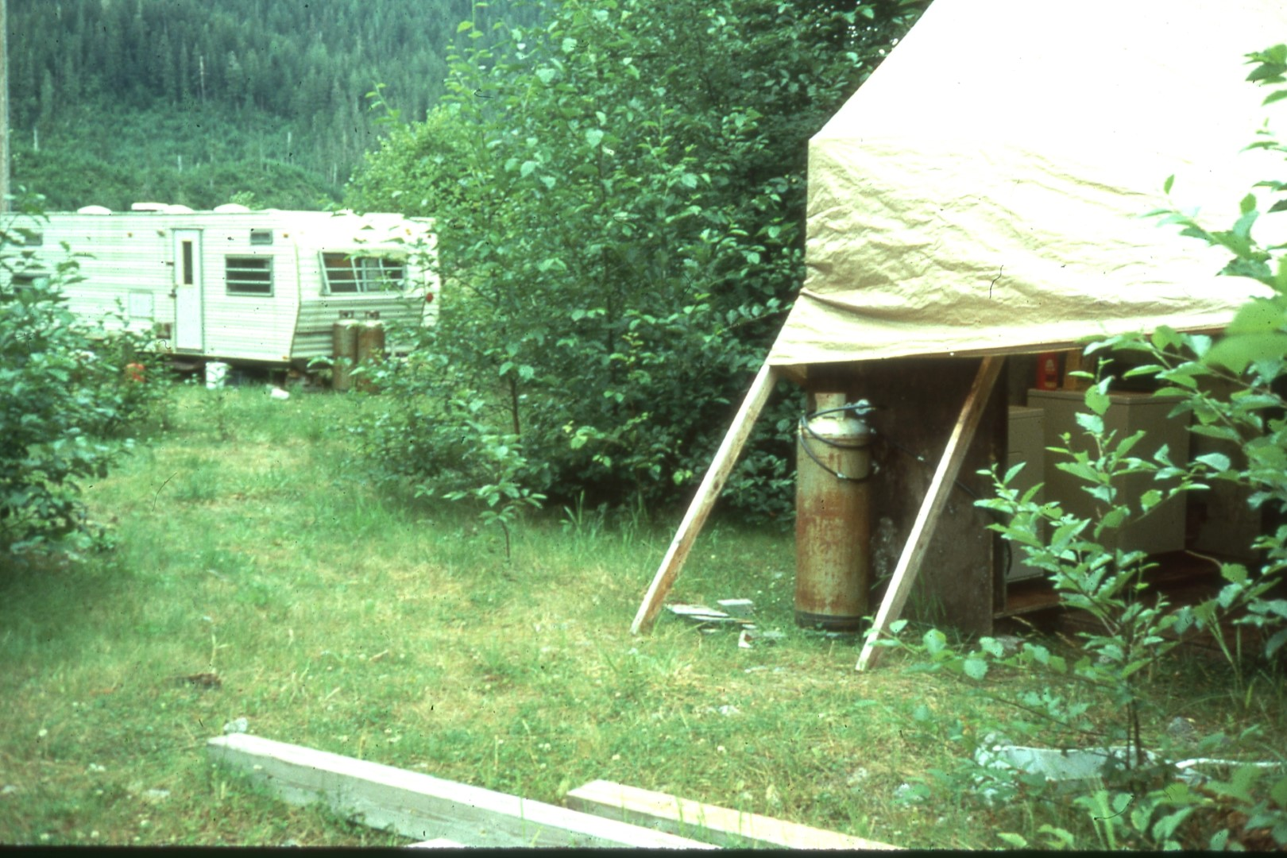
Notes:
They provided two trailers. They provided a washing facility. It’s a cold water wash but it’s got a dryer, a gas dryer, and a drying shed. The grotto has signed a cost-sharing agreement with the Forest Service. They provide certain things, we provide certain things. For those people who are official members of the expedition, they’ll provide a place to stay, they’ll provide your food, and the facilities you see.

Slide 11
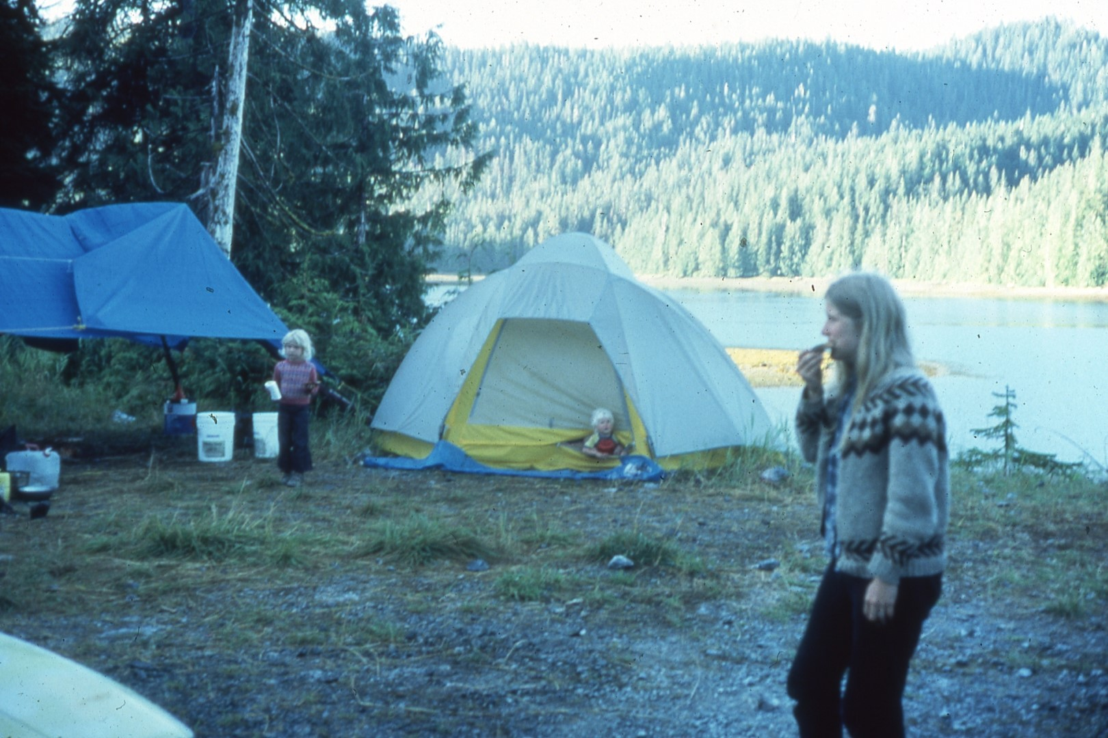
Notes:
Now there’s some of us who go up on our own. I do it because I not only cave while I am up there, but I also will sea kayak.
They also have a restriction that no children are allowed to stay in the work camp, which means that families have to setup a camp outside, as this one showing Carlene Allred and a couple of her kids. A number of us will go camp outside the work camp, go fairly self-sufficient, but still use some of those facilities that are available. If you go up there, you need to make arrangements with the grotto ahead of time, you need to make sure that travel arrangements are worked out, because if you have to be met at Hollis, or at Thorne Bay, then someone needs to be well-aware that you are coming. However, a lot of people will visit up there getting in their campers, going up, and just parking anywhere, particularly if you have a pickup with a camper. I don’t really recommend a trailer. It could be done, but the roads are kinda rough in spots, and it would really jar a camper around. A lot of people have pickups with a camper shell on the back end of it, and you can get around very easily self-contained in that manner.

Slide 12
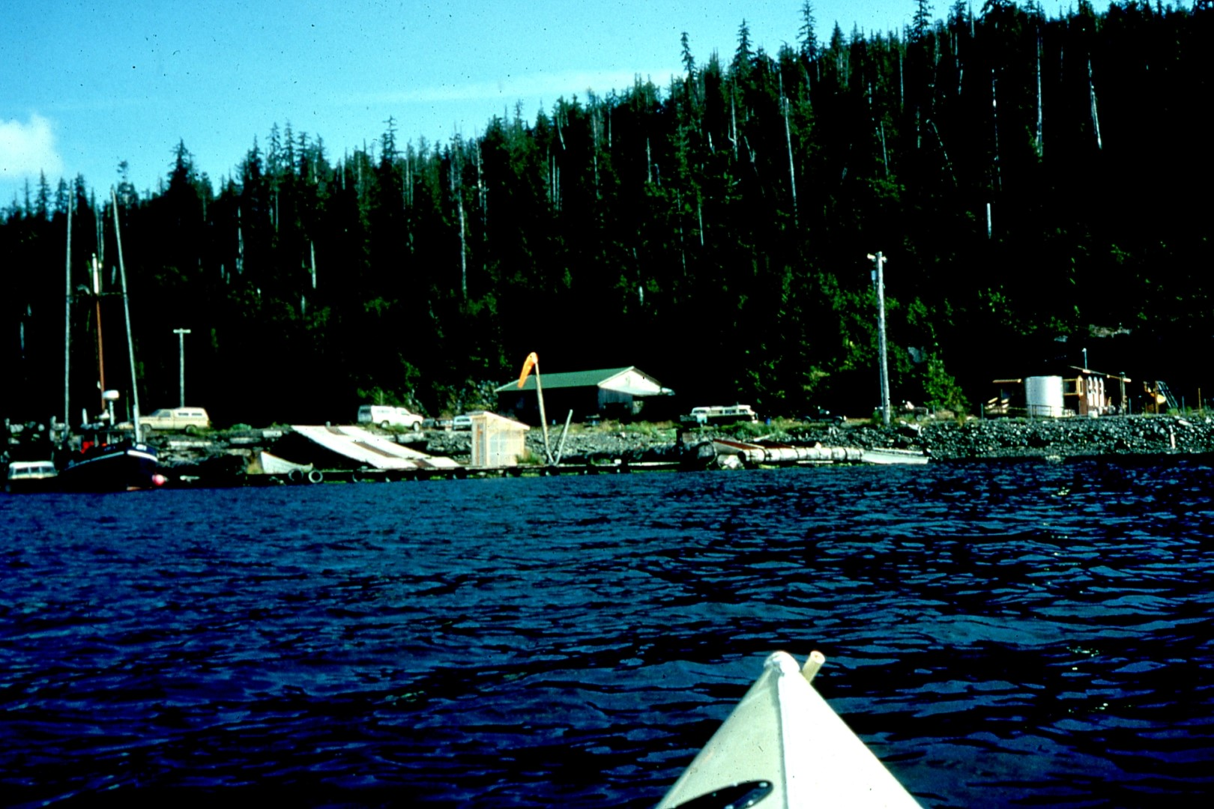
Notes:
As you look around the communities, you are going to find that there’s basically small towns, fishing villages, logging camps, other than the main places I mentioned earlier.

Slide 13
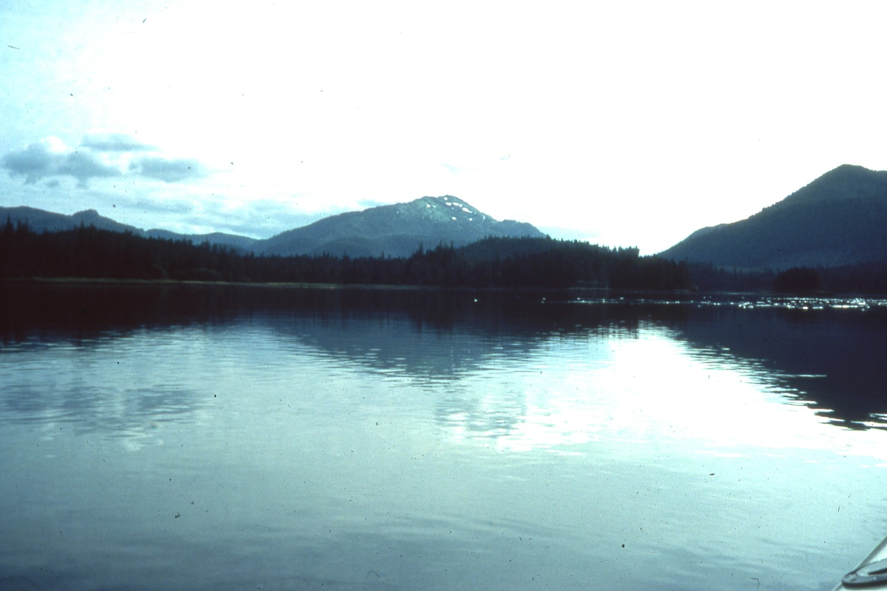
Notes:
The terrain itself is fairly low-lying, a lot of bays and inlets. The mountains that you are going to see are 2500-3000 feet, heavily glaciated, as is, of course, the whole area.

Slide 14
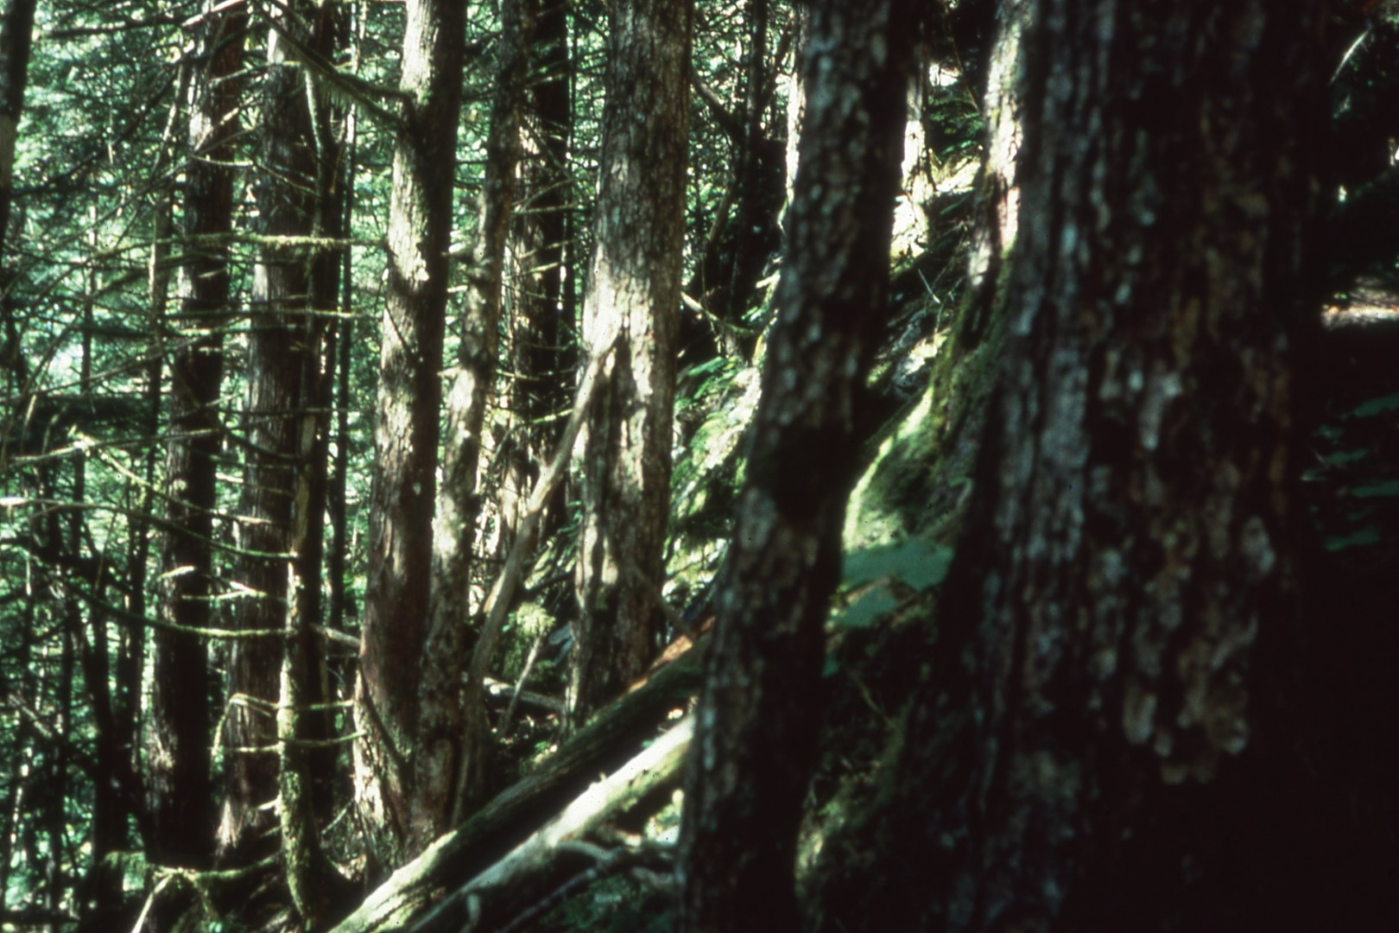
Notes:
The forests up there, what they haven’t clear cut, are rain forests. A word on rain forests is, it can not only be steep, it can have a lot of heavy blow-down and can be difficult to move through, but it’s easier to move through than the clear cut areas. The loggers up there will take their trash, and so forth, that is normally burned in the lower 48, and they’ll throw it any in any little hole around. And, of course, you know what those holes are – they’re sinks. They are depressions in the karst area, and when you try to walk across there, what you are walking on are rotten limbs. Sometimes they’ll break. If you go through the brush, sometimes you’ll take one step, part the brush to see where you are going to put your foot, take another one – it can be quite difficult! Around the edge of the clear cuts you are going to run into a lot of blowdown, heavily brushed up areas.

Slide 15
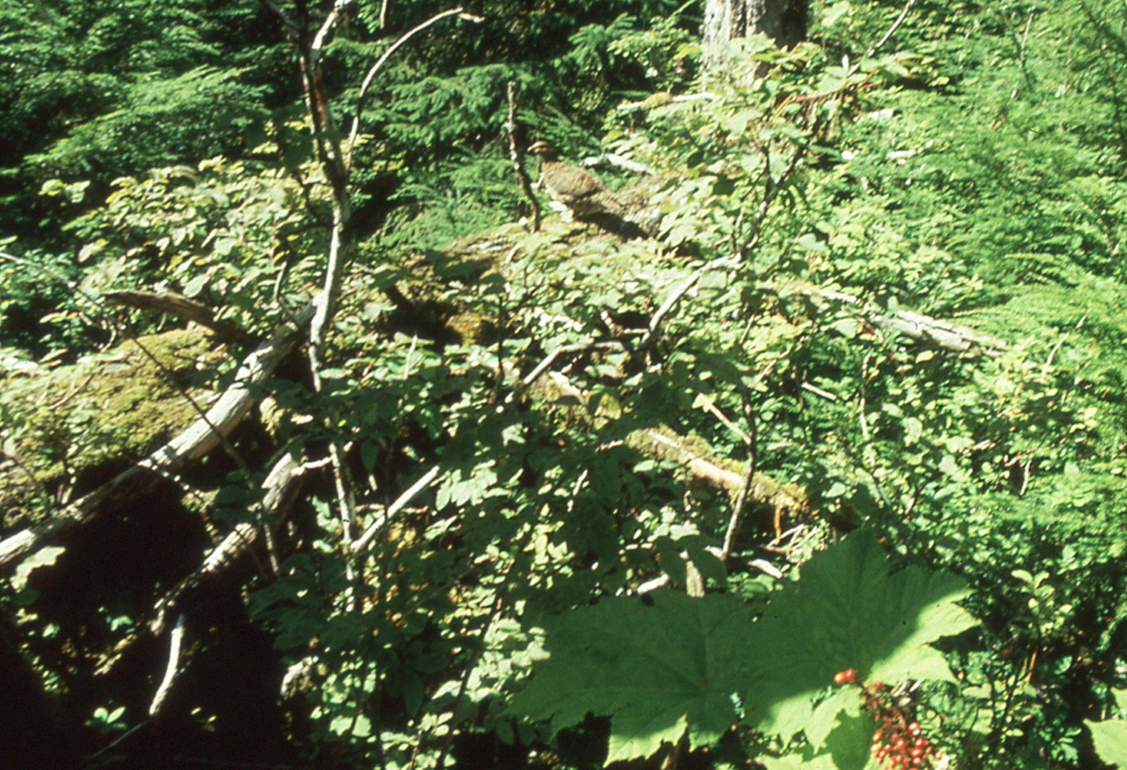
Notes:
The plant that you see in the lower right hand corner is called Devil’s Club. Some of you may be familiar with it’s kinda like the choya plant of the northwest. Choya is the cactus that will throw its barbs at you if you get too close to it. Devil’s Club is almost the same thing. Don’t brush up against its spiny stems, or they will end up in your skin. A friend of mine skid down a slope once, reached out to stop himself, and ended up with his hands full of Devil’s Club thorns, so they are dangerous! And yes, there is a grouse sitting up on that log up there.

Slide 16
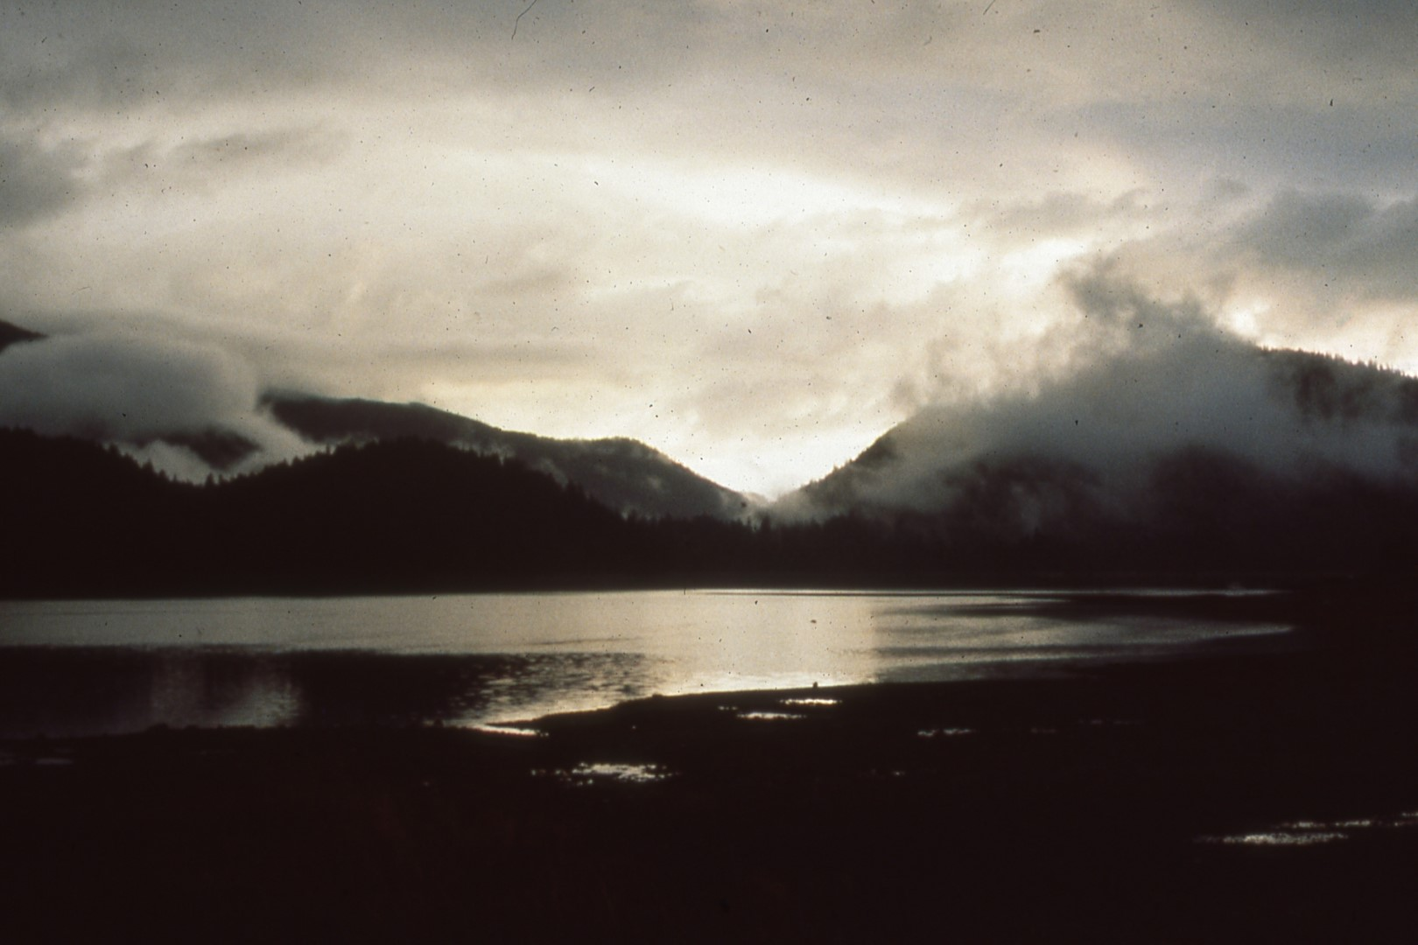
Notes:
The weather? It rains! Now many of the pictures you see are nice bright sunlight. What happens, when it is raining, nobody brings out a camera. When the sun comes out, out come the cameras. The island will get as much as 200 inches of rain on its western coast. The northern Pacific comes in and really dumps a lot of rain. Further inland it may not be as heavy. It may be anywhere from 150 to 100 or less inches of rain per year.

Slide 17
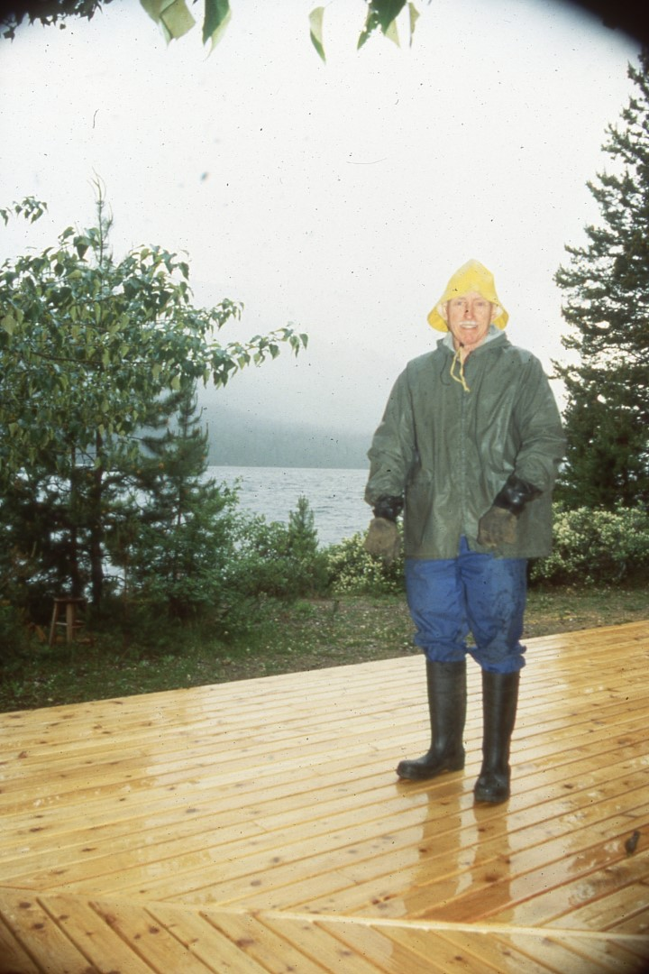
Notes:
What you wear if you’re coming up there? A poncho or light raincoat won’t do it. You need rubber boots, heavy duty rain pants, heavy duty rain jacket, rubber gloves, and a sou’wester just to get around.

Slide 18
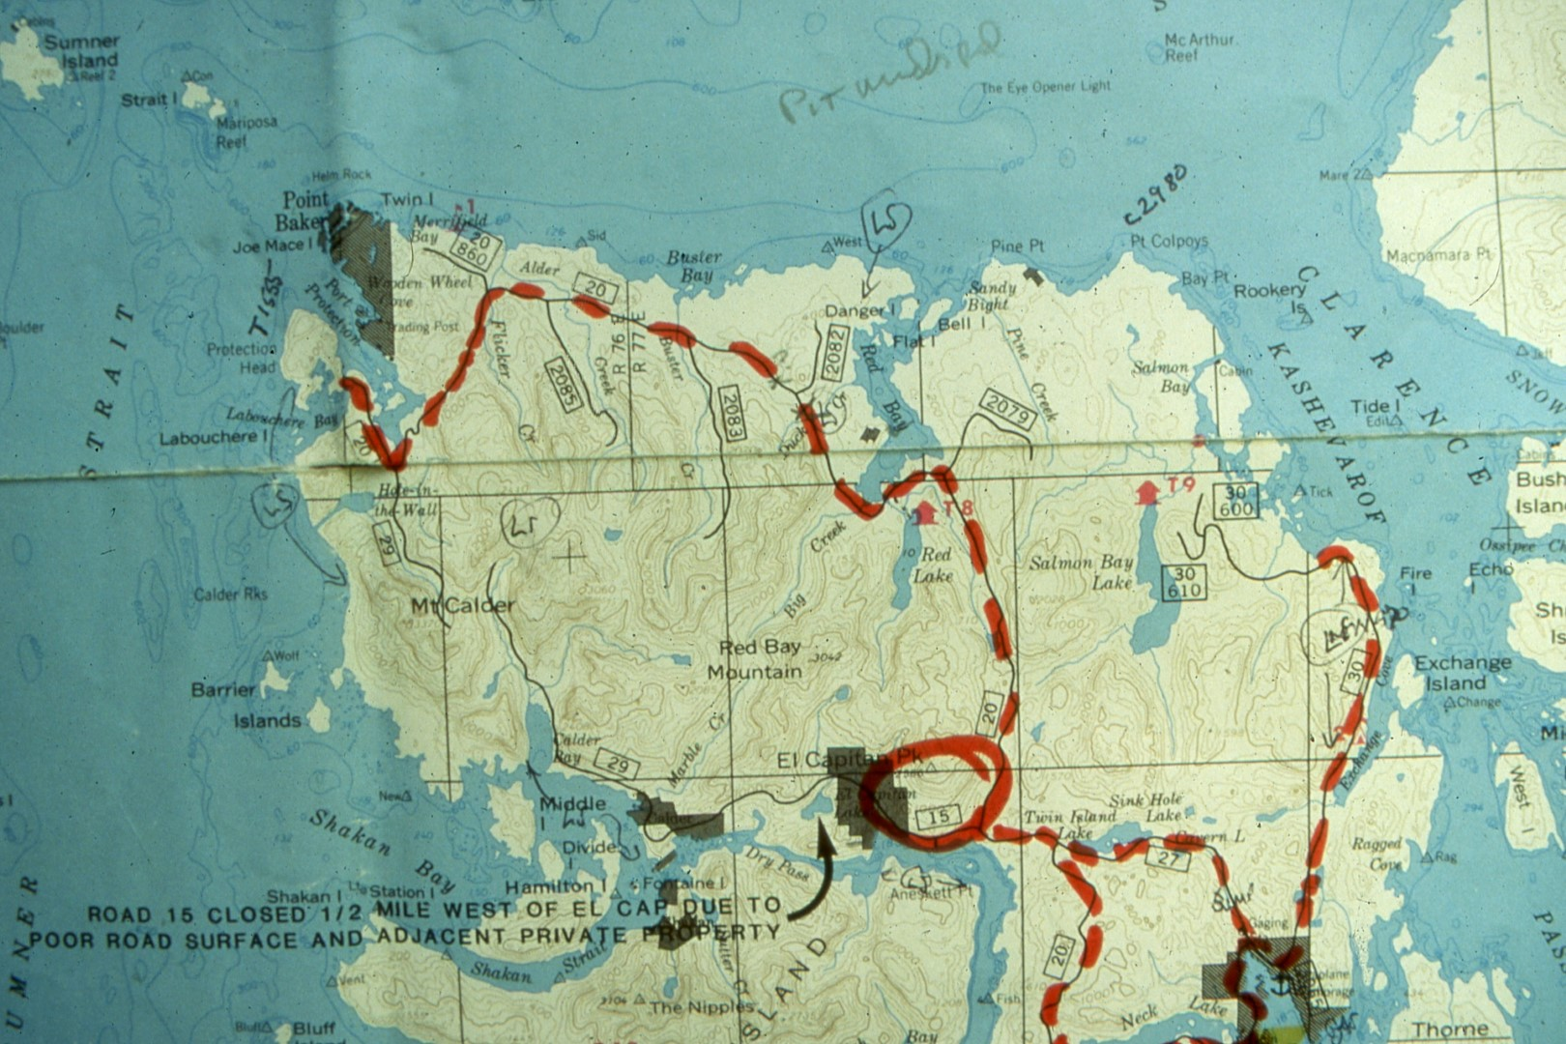
Notes:
This is a map of the northern part of the island. The El Capitan work camp is located at this point. El Captian Mountain is right behind it. The road going over to Whale Pass, located here. This is the Exchange Cove area, which I will talk about. This area over in here is Pru Peak, Flicker Ridge, Calder Mountain, Calder Bay area. This is El Capitan passage going down this way.

Slide 19
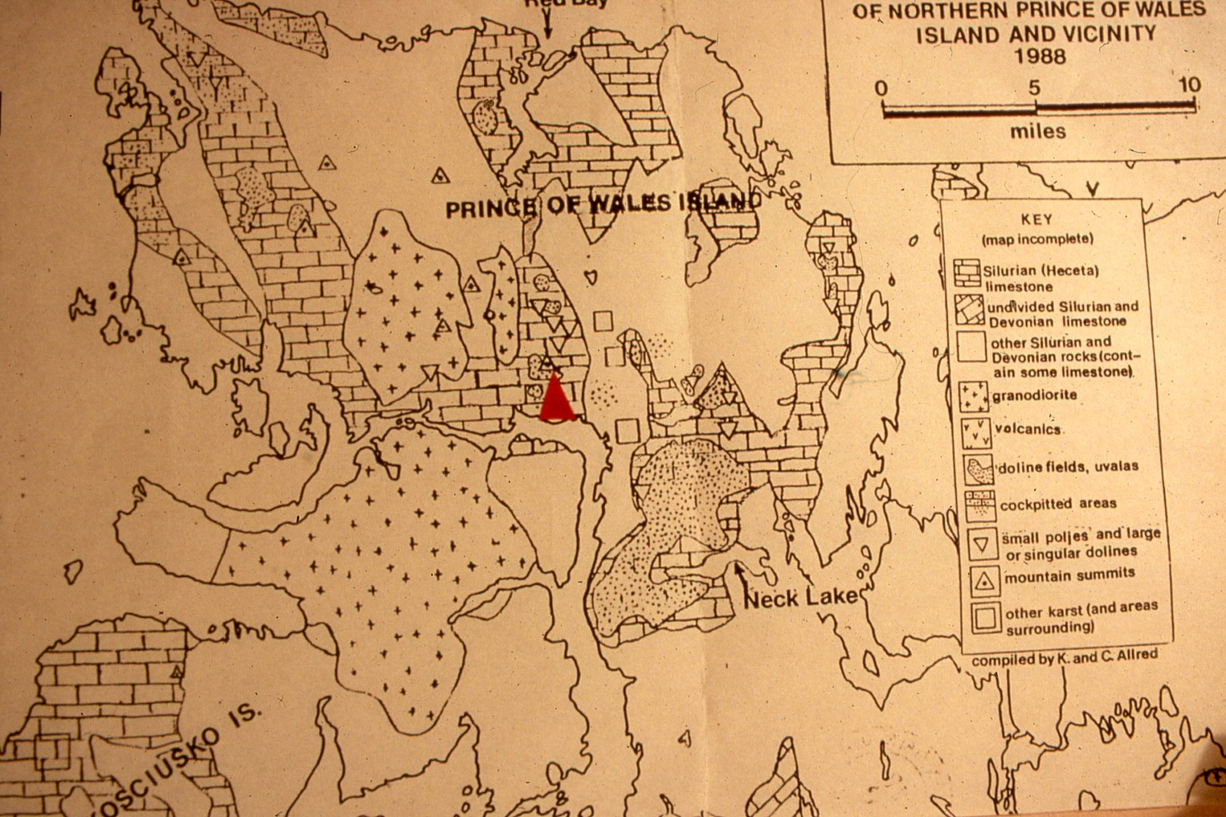
Notes:
For limestone – the square blocks are limestone – you’ll notice there is a great deal of limestone up there. This type of thing, you’ll find a number of different types of cap rock, some, or most of it, is non-carbonate. And we found that as you are looking for caves, start following the streams over the non-carbonate rock. When you get to the limestones they just dive right down and you’ve got a cave. Our procedure for finding these up there has been , we try to get the Forest Service and the local people that are out rambling around in the woods, when they find a hole, report it. Then we can go and check it out and see if it’s a cave. It’s a lot better than us, as cavers, wandering around trying to see what is in a given area. The limestone is Aketta Limestone. It’s been there over 300 million years. It’s anywhere from 9000 to 11,000 (feet) thick. It’s pretty well settled. You don’t find a dip or a plane such as you find in many places, and much of it is below sea level. El Capitan Pit on El Capitan Mountain is at about 2300 feet, so you can see there is a lot of limestone up there and a long way to go.

Slide 20
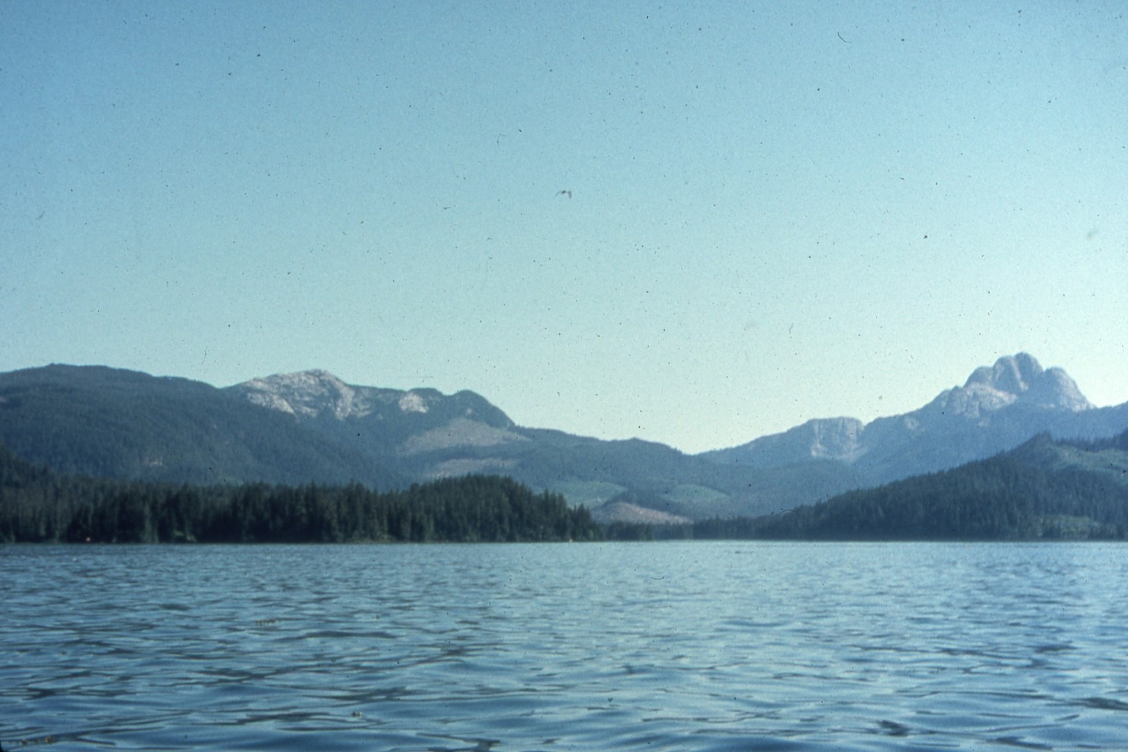
Notes:
This is a view of Calder Mountain to the west. It’s pure limestone. It has been explored very briefly. Kevin Allred and a helicopter pilot got in there. They walked around some on the mountain. We’ve hardly touched it. Kevin also, along with a couple others, got into Pru Peak, which is the white peak to the right. This also has a number of caves on it. They found great potential, but we just haven’t had the time or people to really get into this area.

Slide 21
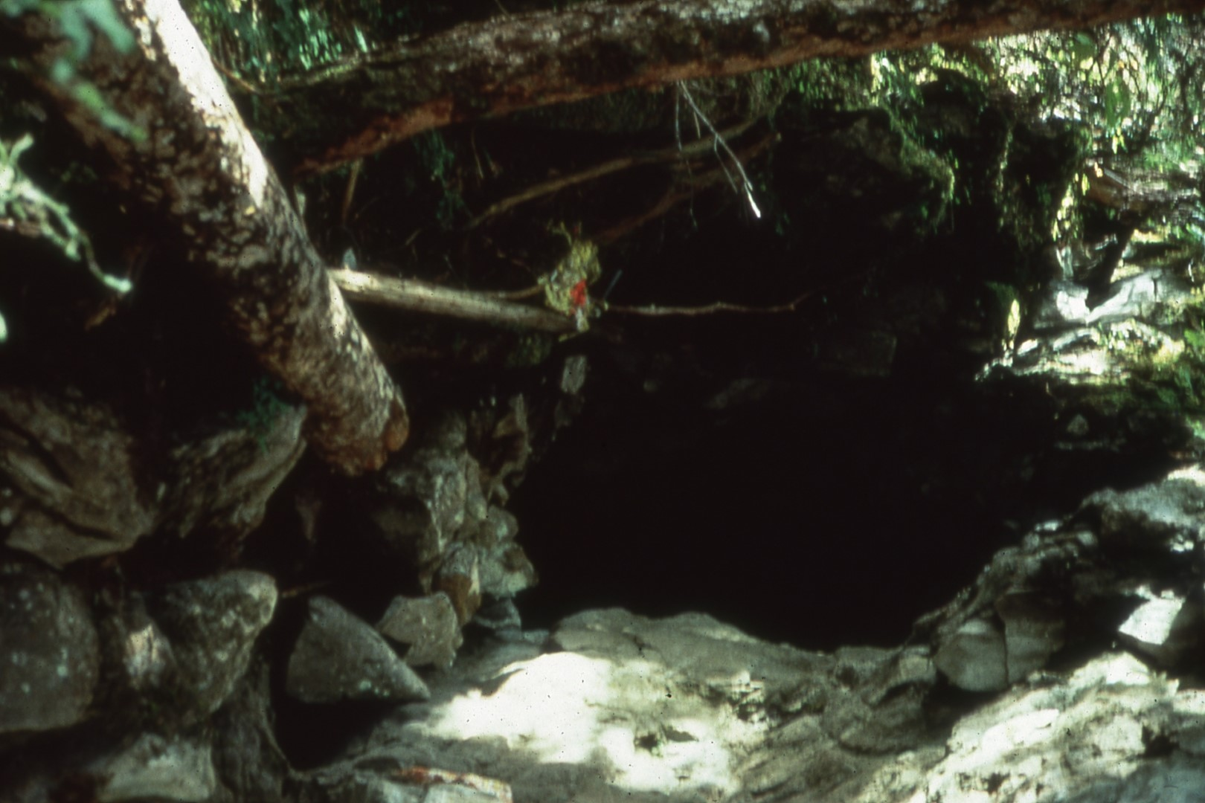
Notes:
The most interesting cave to date, that we have found, is El Capitan Cave. It is located within about 5 or 6 hundred meters from the work camp. Probably been known to the locals for some time, however, the cavers were not aware of it until in ’85, Dave Hatfield, a Forest Service geologist, located it. Told the Allreds about it in ’87. They followed procedures we do on all out activities up there, is when you go into a cave you start surveying. When you stop surveying, the next team that comes in gets to survey virgin cave.

Slide 22
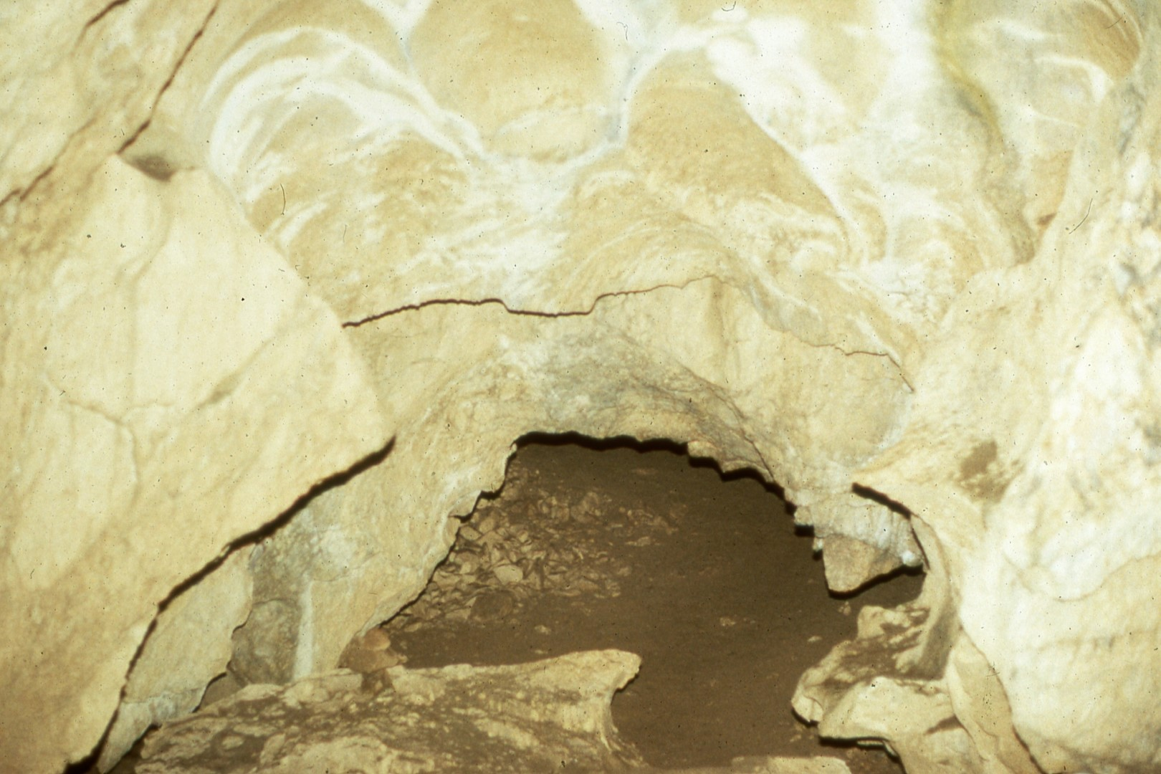
Notes:
The Allreds came in, climbed over some breakdown, went through some passage, went through this duck-under, surveying as they went,

Slide 23
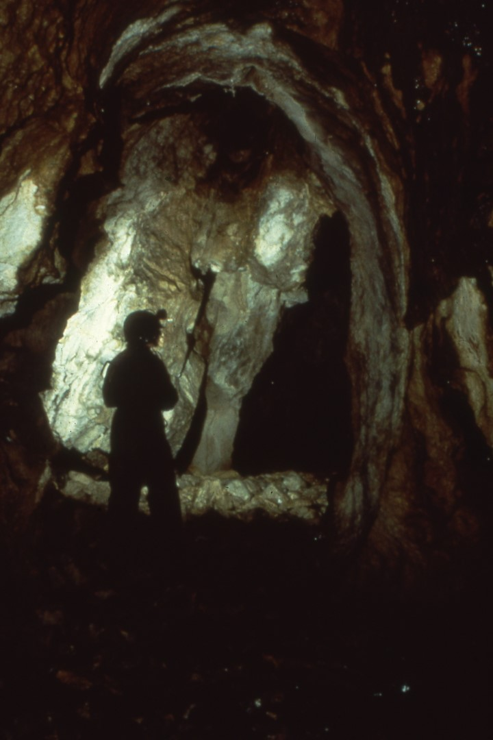
Notes:
and found themselves in walking passage, anywhere from 10 to 20 feet wide and 20 to 30 feet high. Cobbled in places, mud or sand in the bottom in some places, and as they looked around, why, there were passages going everywhere.

Slide 24
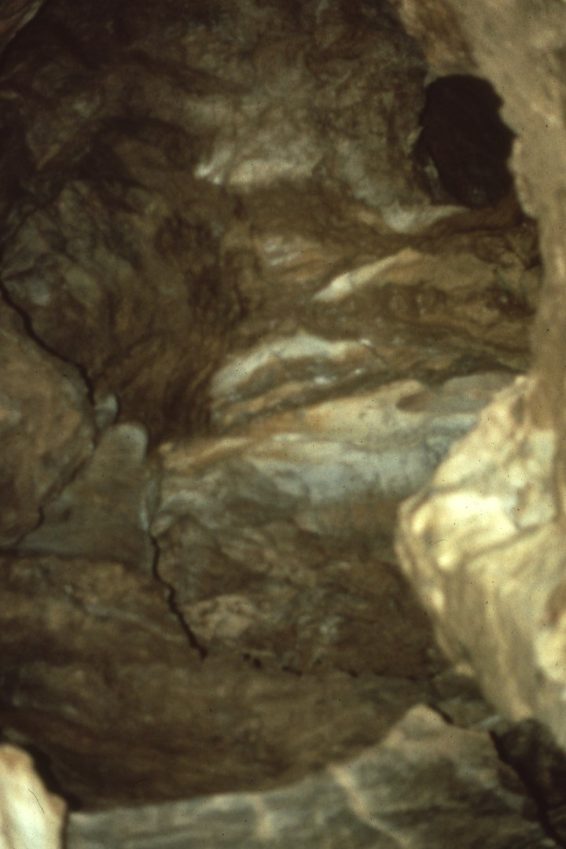
Notes:
This is looking up in the cave. Some of the upper passages connect, as they’ve slowly surveyed it. To date we have surveyed 10,033 feet of cave and there’s still about 12 leads yet to be surveyed and who knows what we’re going to find as we work through these various leads.

Slide 25
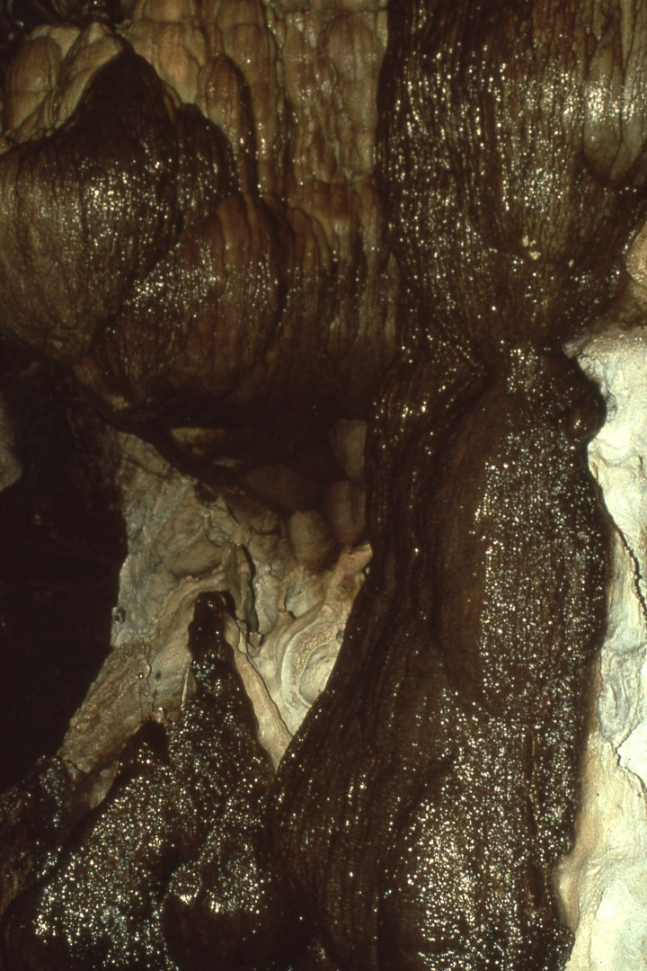
Notes:
The front part of the cave has a few formations in it. This is called the Chocolate Sundae because of its unusual coloring. Not many formations in Alaska caves, and certainly they cannot match up with those of the southwest, but when we find some formations we are happy with them.

Slide 26
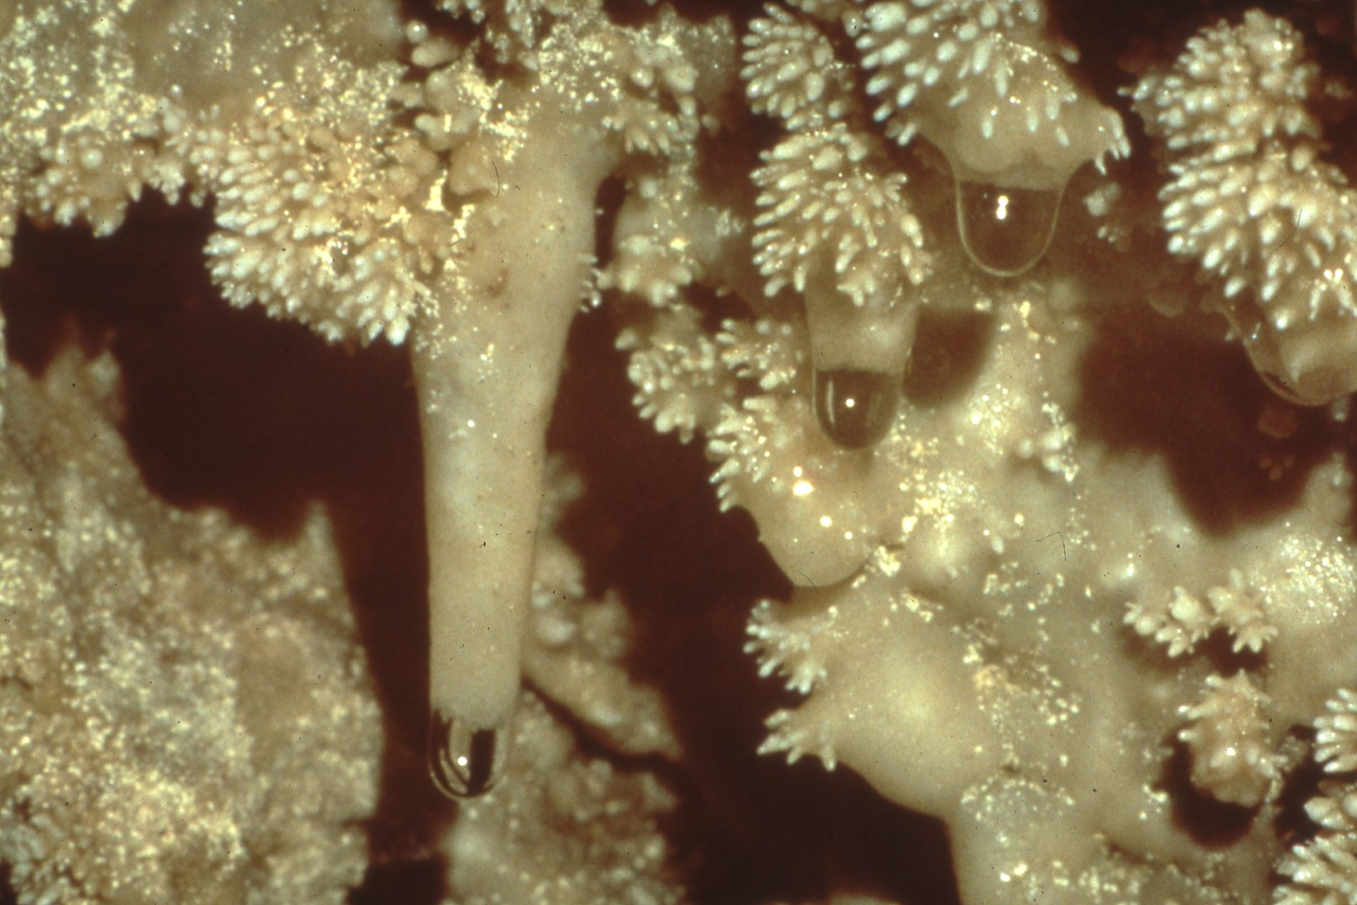
Notes:
(no narration)

Slide 27
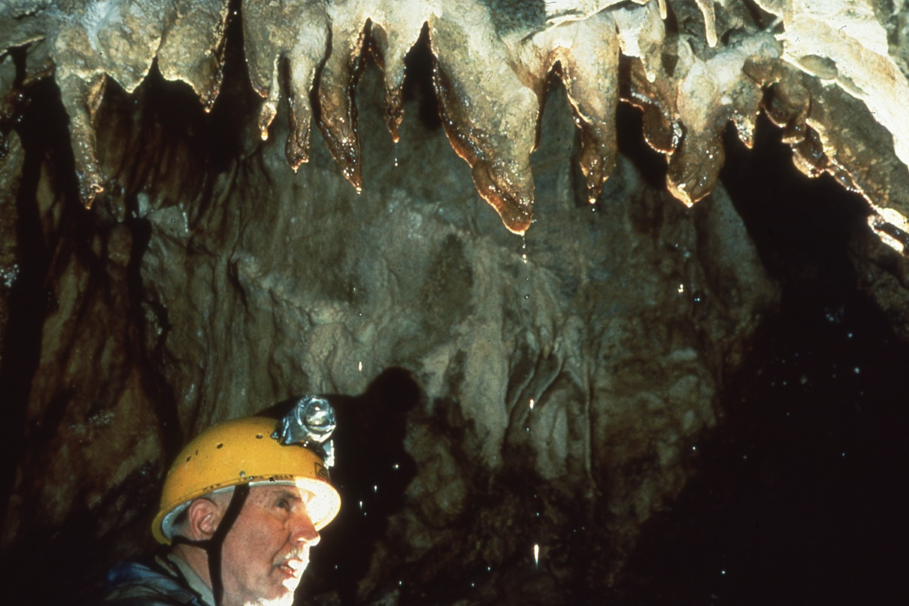
Notes:
This gentleman is Dr. Jay Rockwell. He is 73. He had a hip replacement about a year and a half ago, and as a result of that his back was bothering him a little bit, but he’s still hobbling in and out of caves to this date.

Slide 28
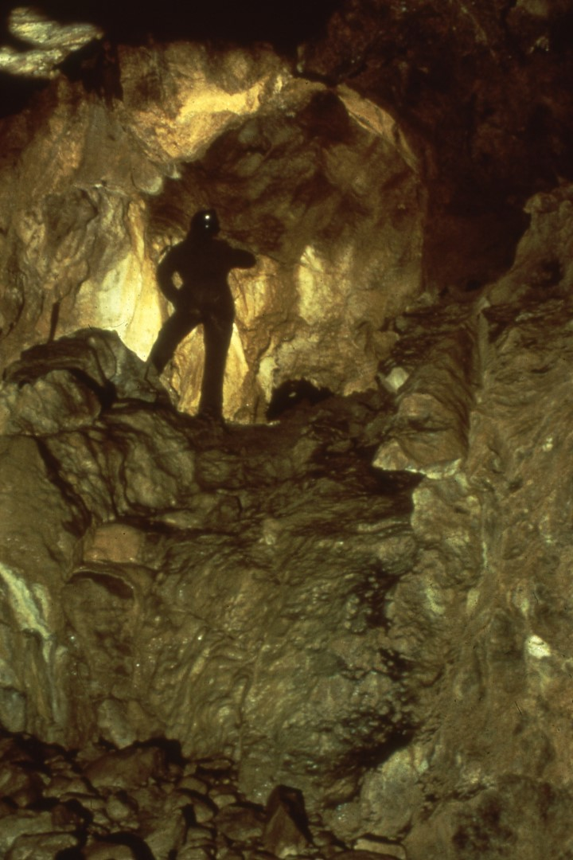
Notes:
We started working, and exploring some passages, went past the Ball Bearing Passage, and past an area where there’s a sump. We got back there and got on the other side, passages opened up again, and we were able to double the size of the cave from what we knew it was there in 1988. This was done at the end of the 1988 expedition. In 1989 they continued surveying back through there, found a great big room located under two large sinks. At one time they were connected, or the sinks were open, because there is a big log sitting in the middle of that room.

Slide 29
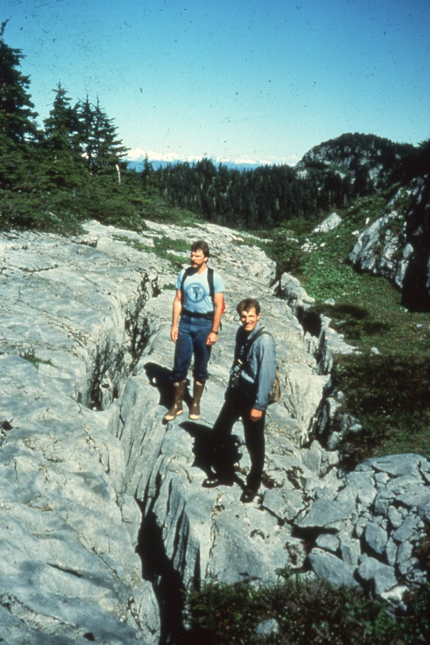
Notes:
About the same time in ’88 three of our cavers, Kevin Allred, who is on the right, Dave Hatfield on the left, and Harvey Bowers, who took the picture, hiked up to the top of El Capitan Mountain and back across the non-carbonate cap to a karsted area. What they found was it was riddled with cracks, such as you see in this picture.

Slide 30
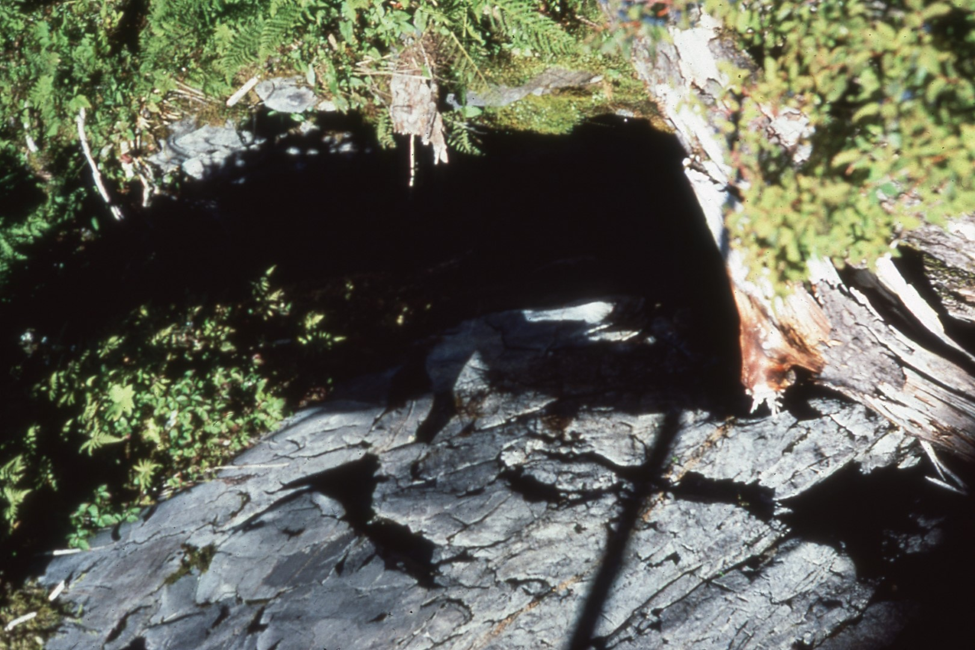
Notes:
There were pits of various sizes, shapes, and one thing and another. Some of them were filled with debris – you’d think you’d be walking across grass and all of a sudden you could fall through. Extremely dangerous area! They ended up finding a pit. It was a large pit.

Slide 31
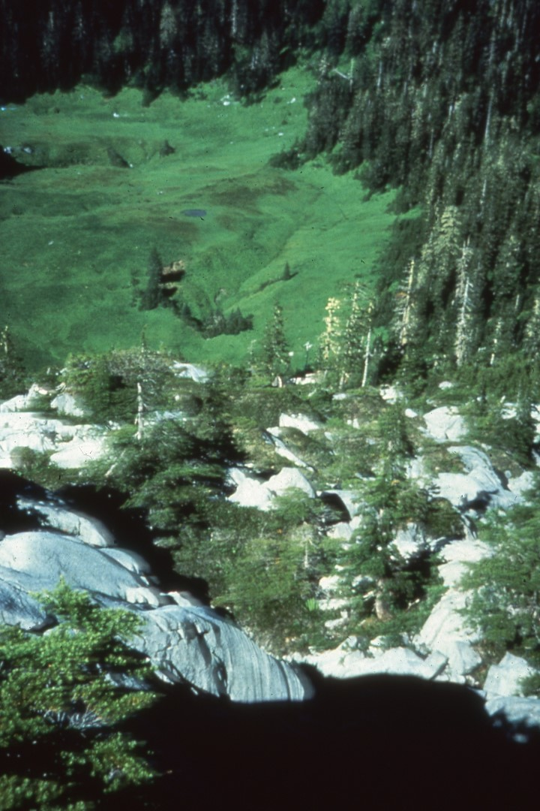
Notes:
This is a slide of some of the karsted areas and a pullya which is up there. And the particular pit they found was given the name El Capitan Pit. We had a total of 400 feet of rope in camp and on the 25th of August a helicopter flew us in, or we were flown in by the Forest Service.

Slide 32
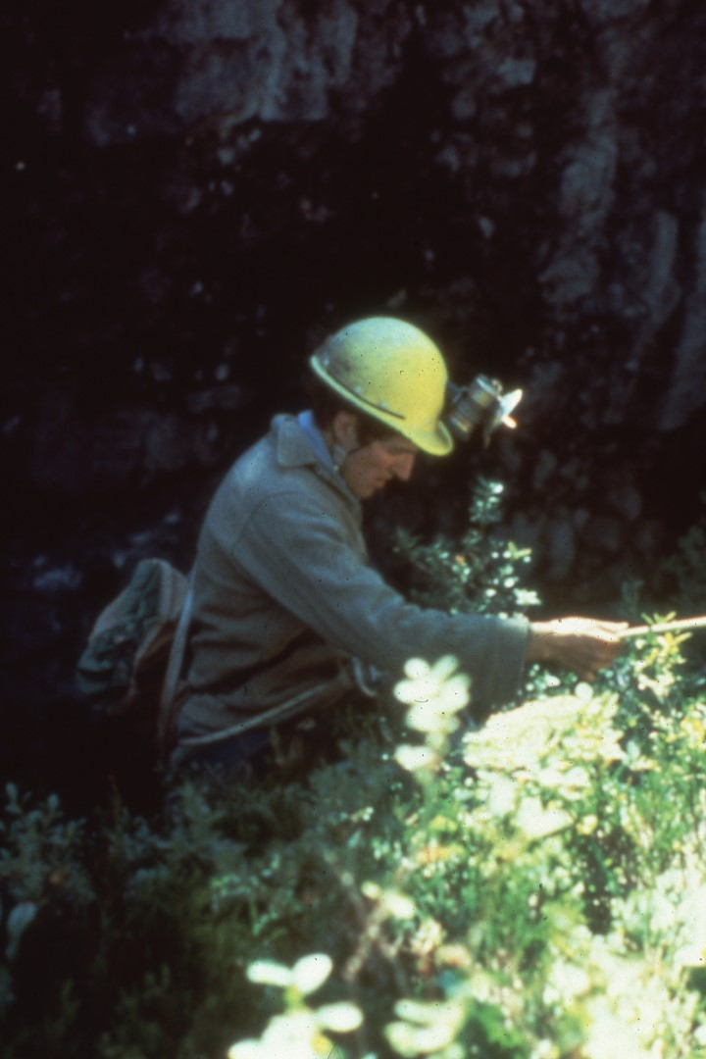
Notes:
The first two people down were Kevin and Miles Hecker from Casper, Wyoming. This is a slide of Kevin starting down. In ’89, because the heavy weight of the rope cut into the moss and so forth at the edge, they put the tail over the edge, went down the tail, then switched over to the main line and went on down.

Slide 33
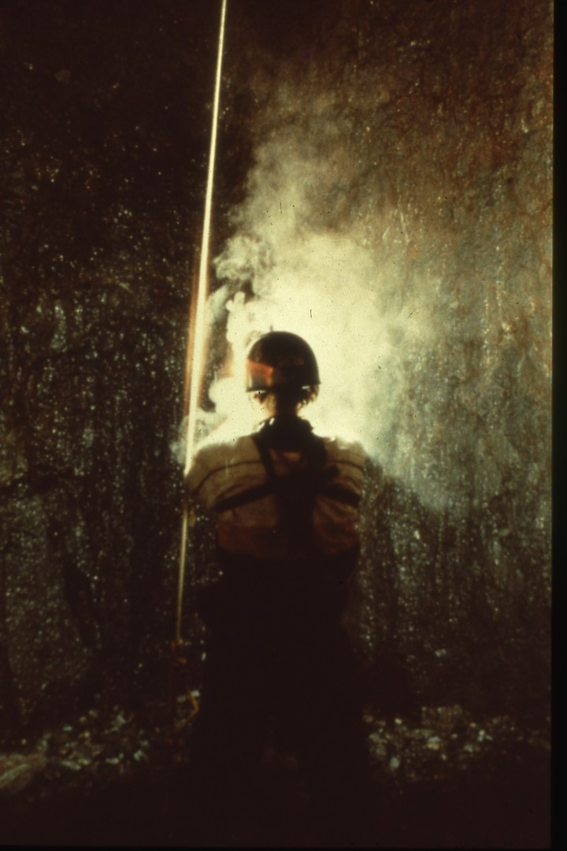
Notes:
The next couple pictures, while not particularly good, were taken by Carlene at the bottom on a later descent, and it will give you a good idea of what they found when they got down there.

Slide 34
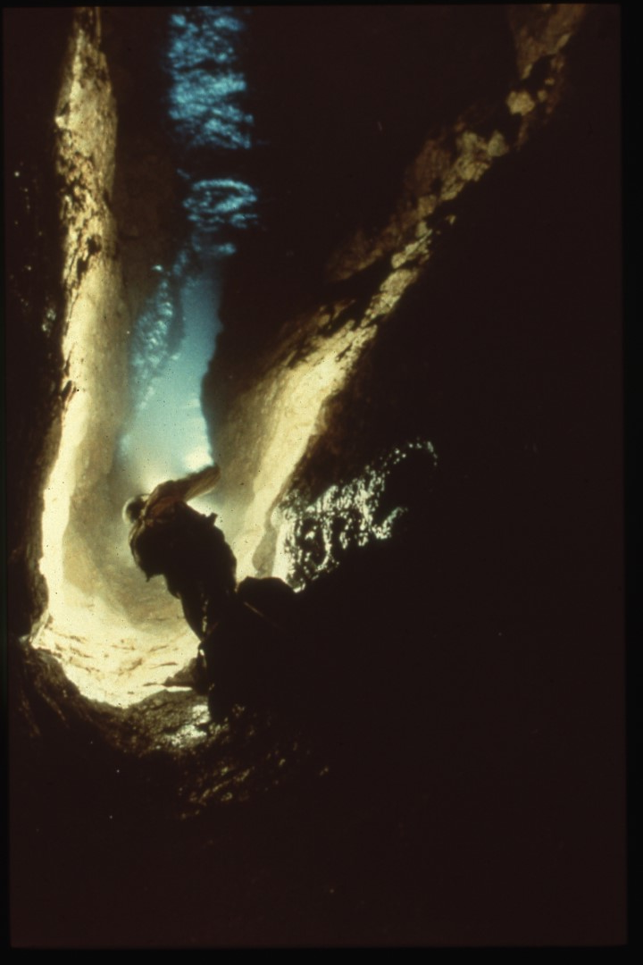
Notes:
(no narration)

Slide 35
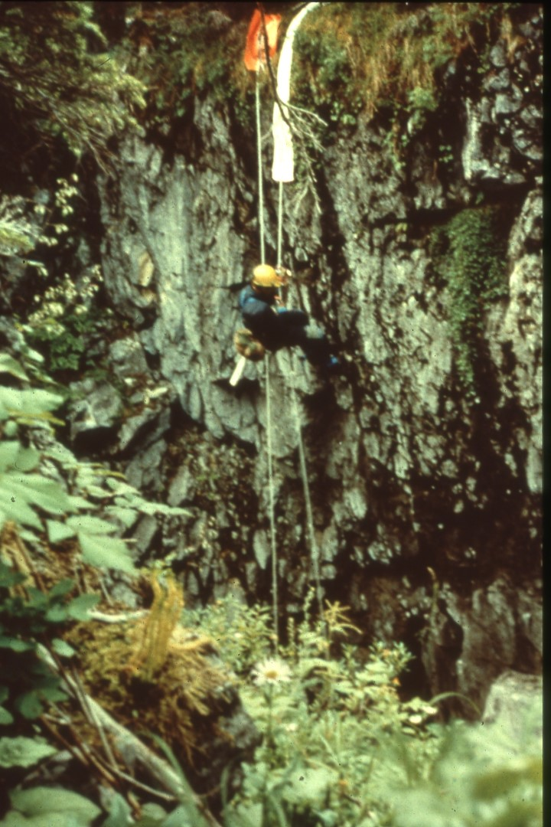
Notes:
This is Mike heading on out of the pit.

Slide 36
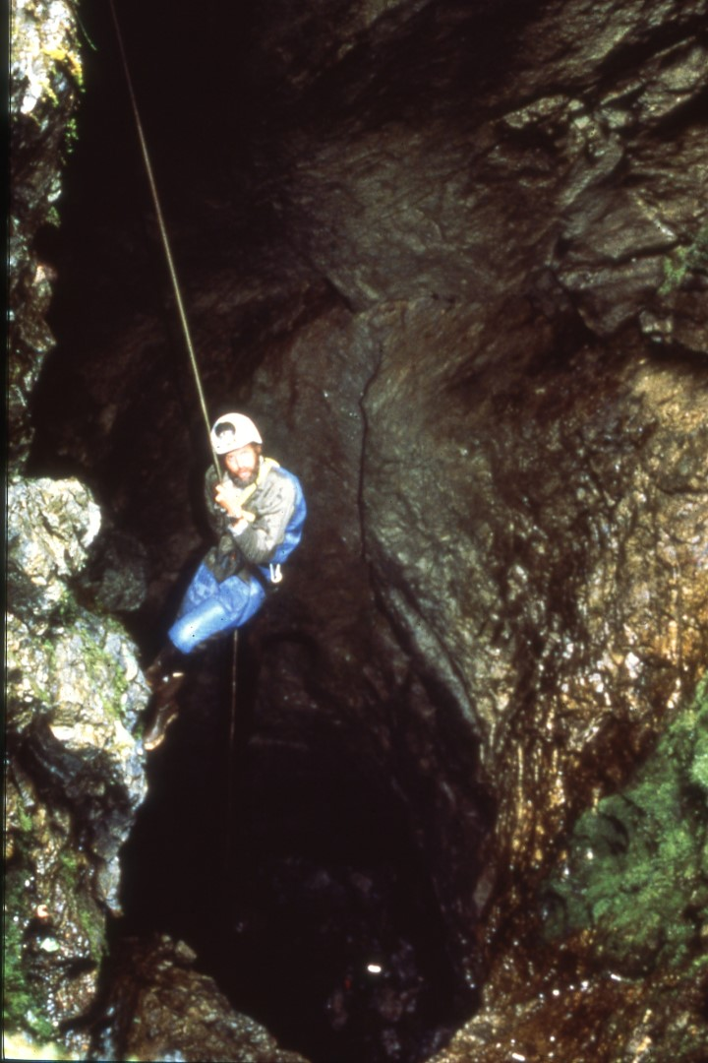
Notes:
One of the more interesting caves that we’ve found, and this is Steve heading down into Captain Soup Cave, named for the Forest Service point-of-contact, who is a part-time commercial fisherman and his CB handle was Captain Soup.

Slide 37
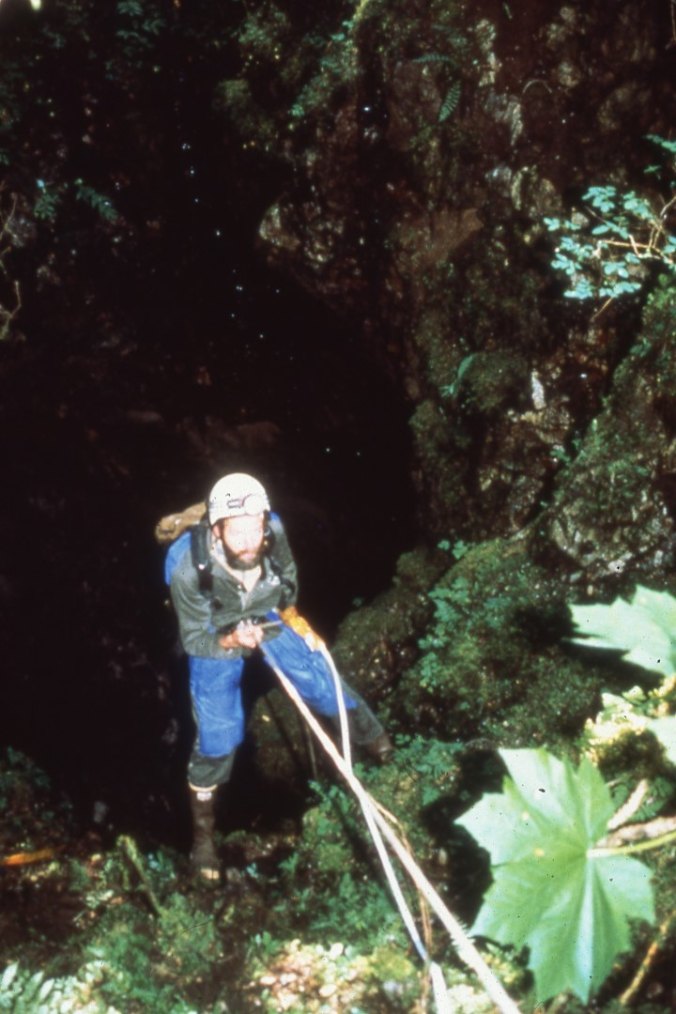
Notes:
(no narration)

Slide 38
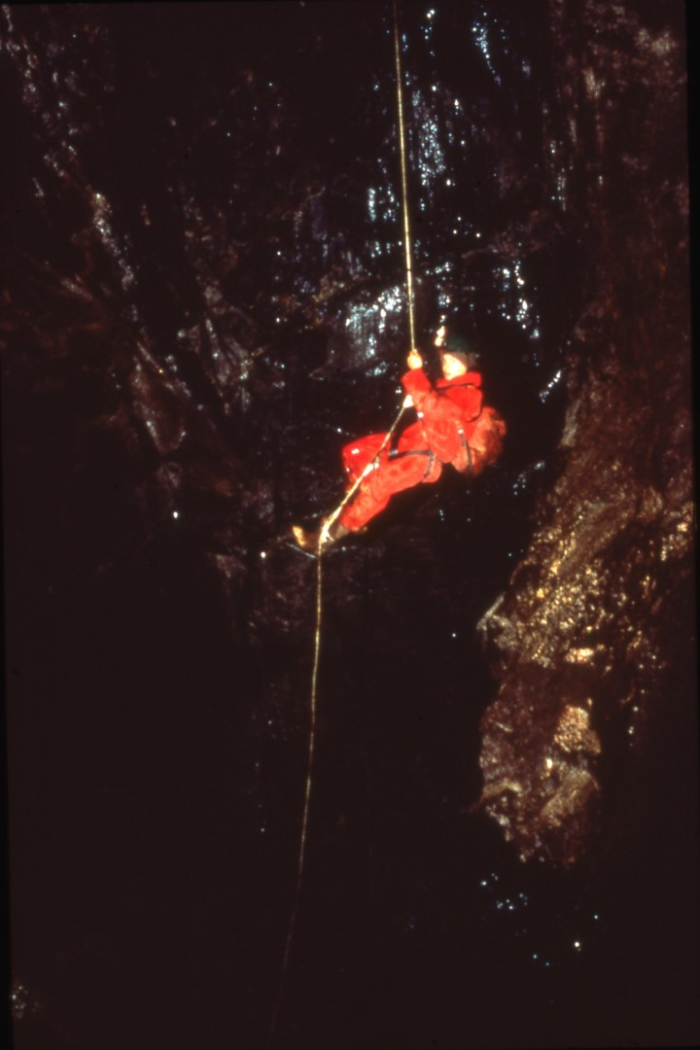
Notes:
It has a 35 foot pit, a little ledge, and then another 35 foot pit.

Slide 39
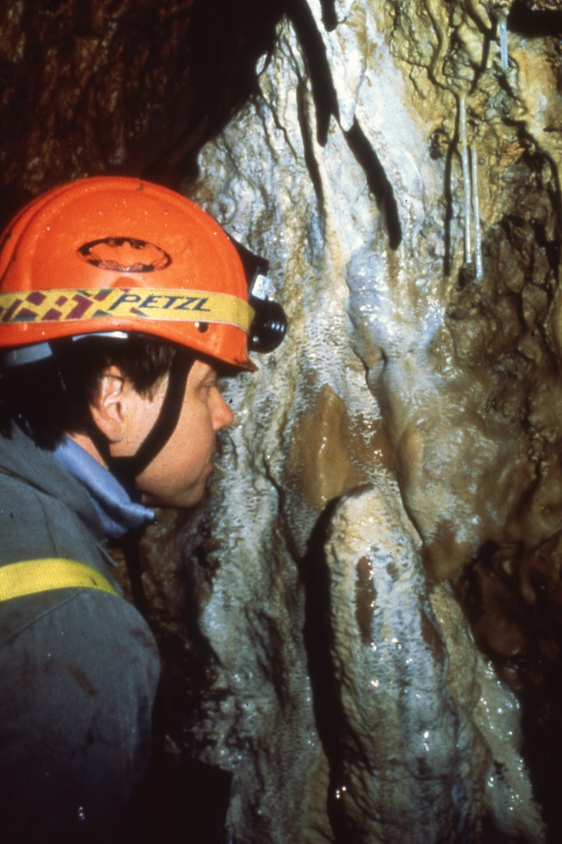
Notes:
We found it was well-named. Bob Bastasz was looking at some of the slime that coats this entire cave, and this is sticky, icky, gooey mud! Maureen Handler was telling me about something she had encountered in Russia; this is the same sort of stuff.

Slide 40
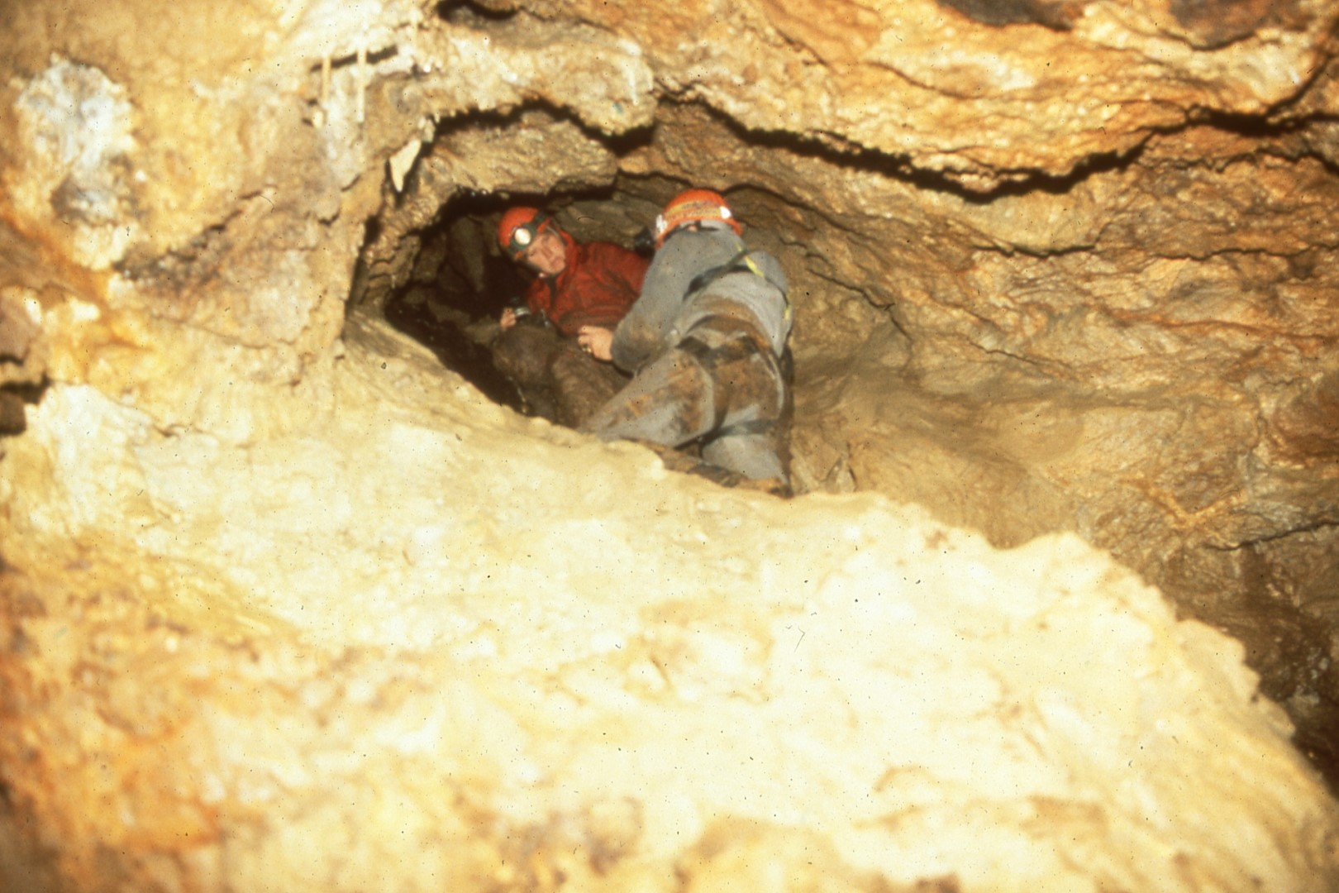
Notes:
We didn’t get many pictures in this cave, but it does have some formations. And because of that we were able to get the Forest Service to cancel the timber sale they had planned and they are providing some protection for the cave. I’ll just run through a few of these very quickly.

Slide 41
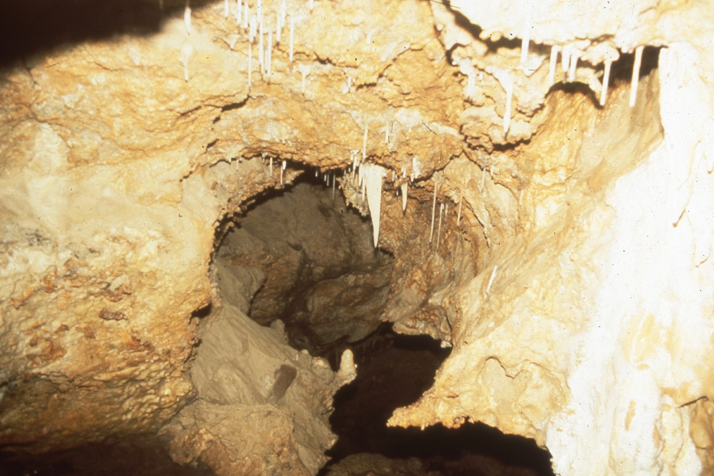
Notes:
(no narration)

Slide 42
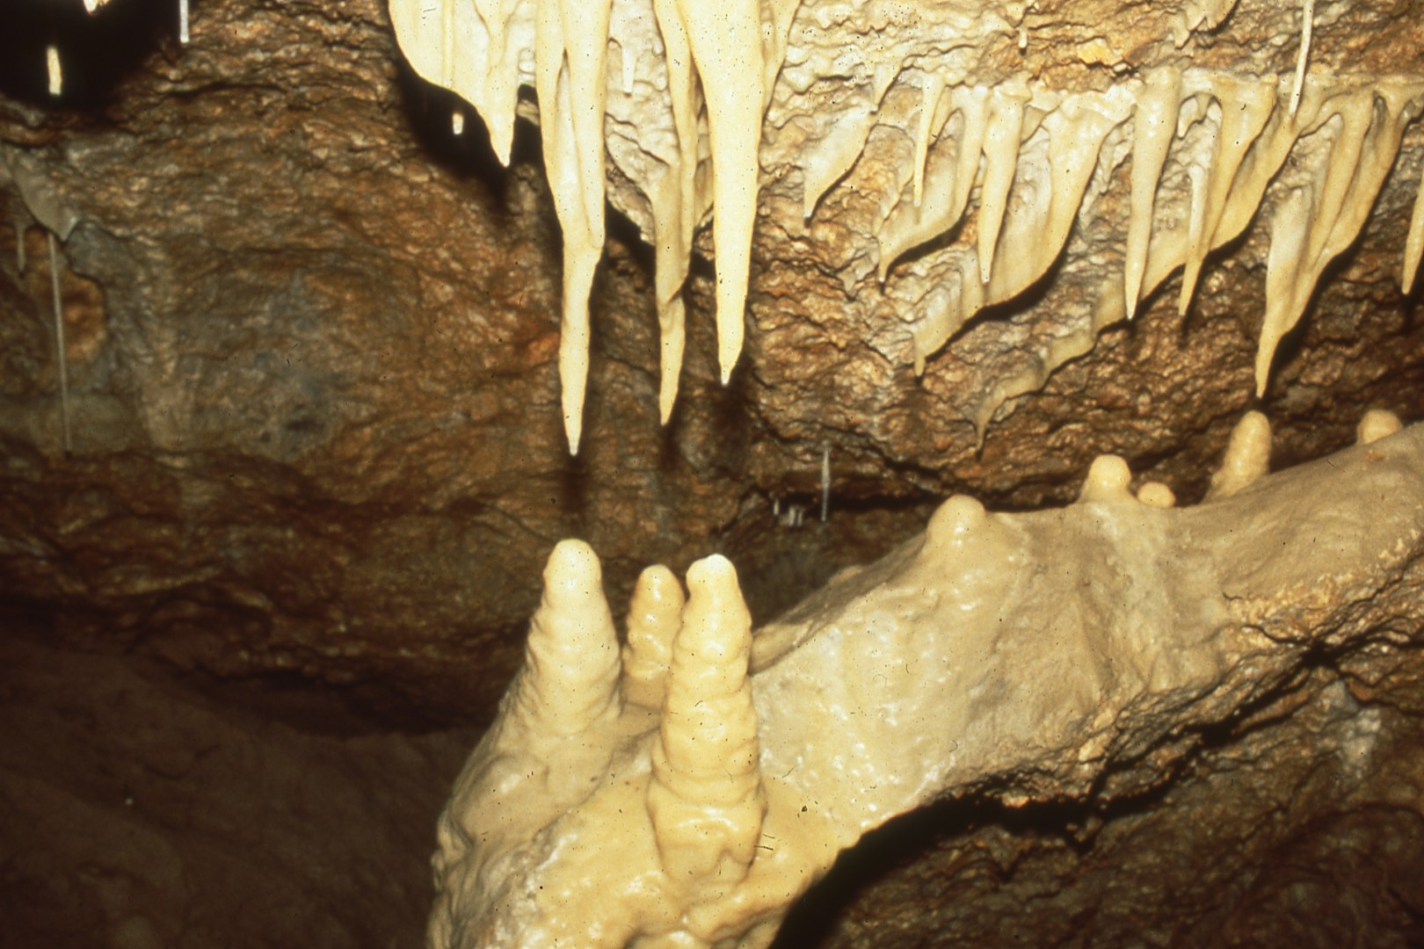
Notes:
(no narration)

Slide 43
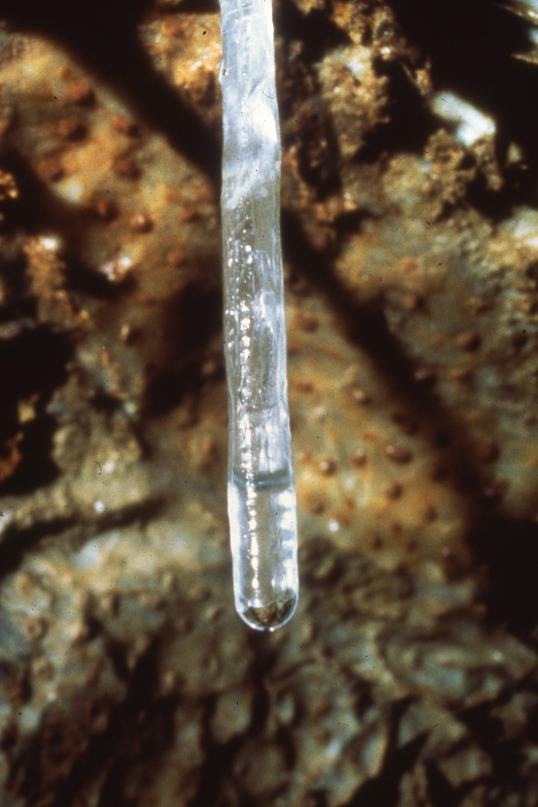
Notes:
We do have a few soda straws in there.

Slide 44
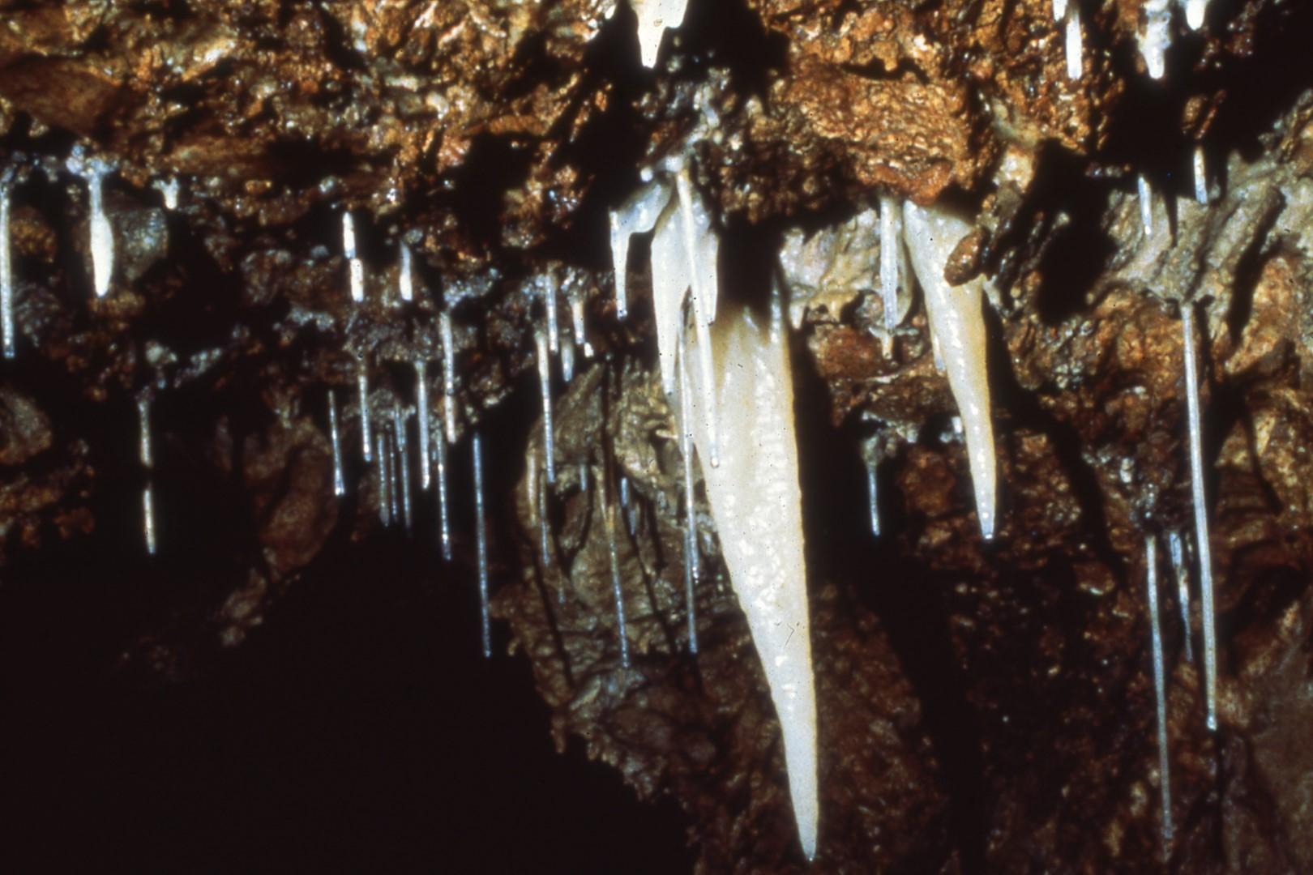
Notes:
(No narration)

Slide 45
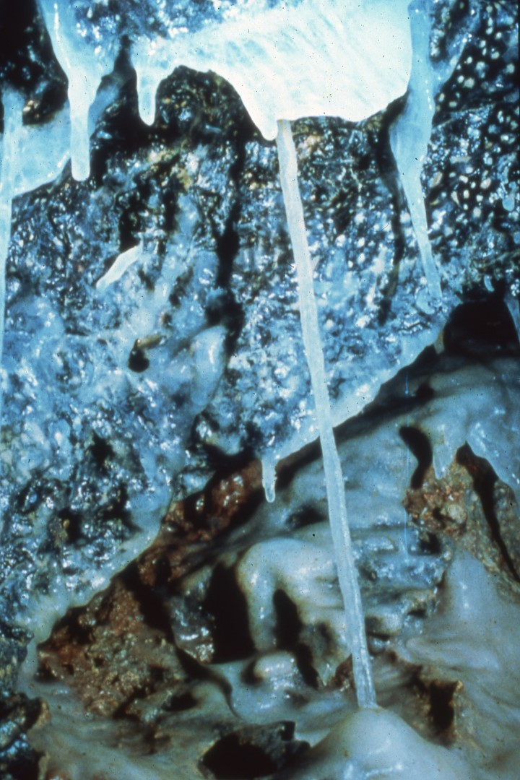
Notes:
(No narration)

Slide 46
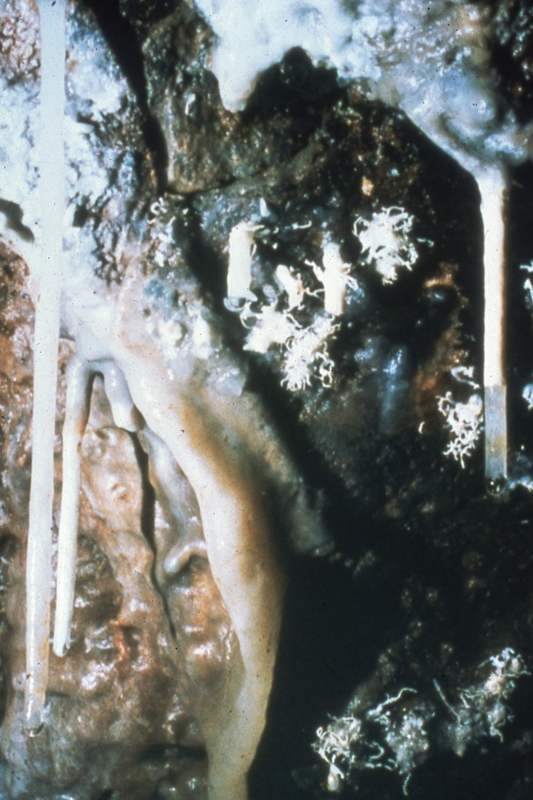
Notes:
(No narration)

Slide 47
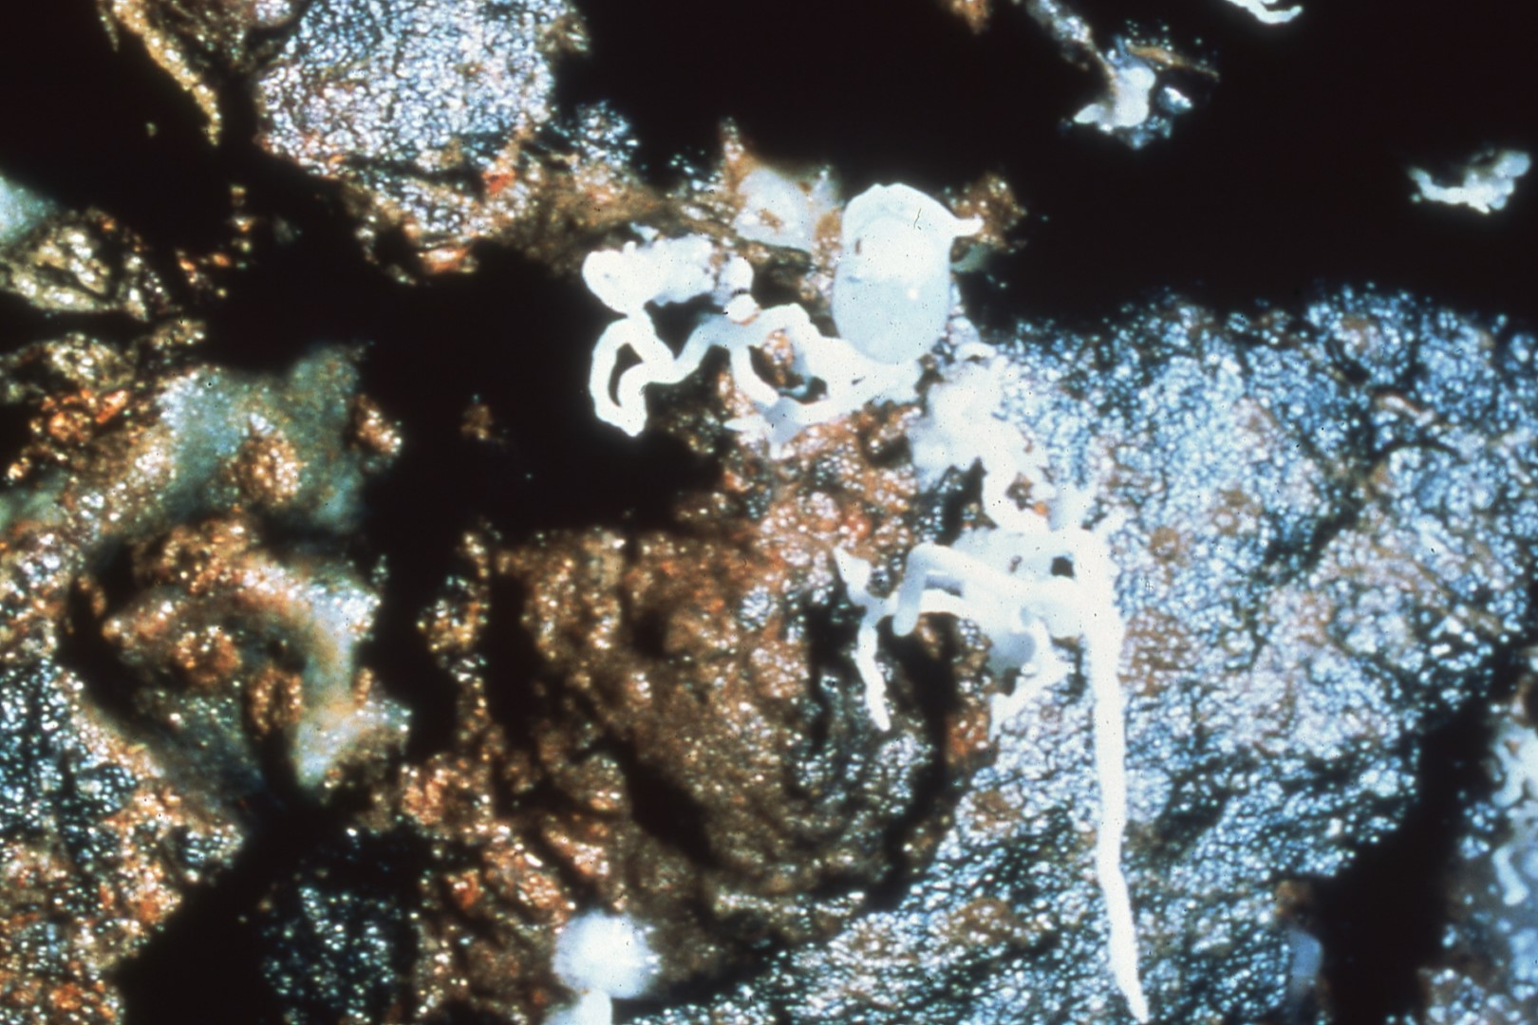
Notes:
We even have some helictites, not very big, but they are there.

Slide 48
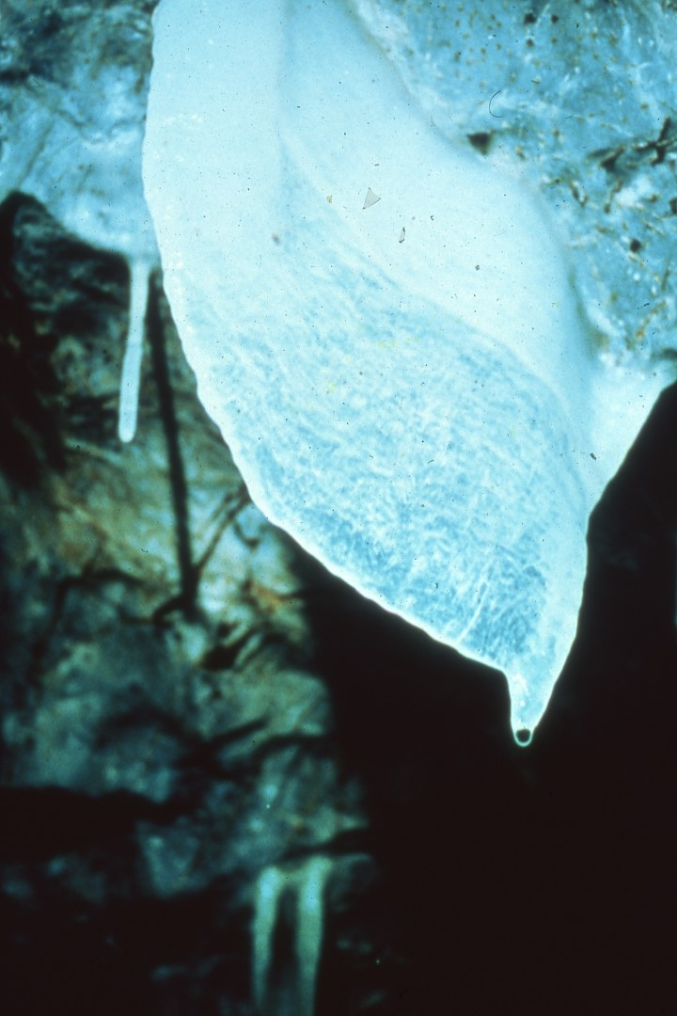
Notes:
(No narration)

Slide 49
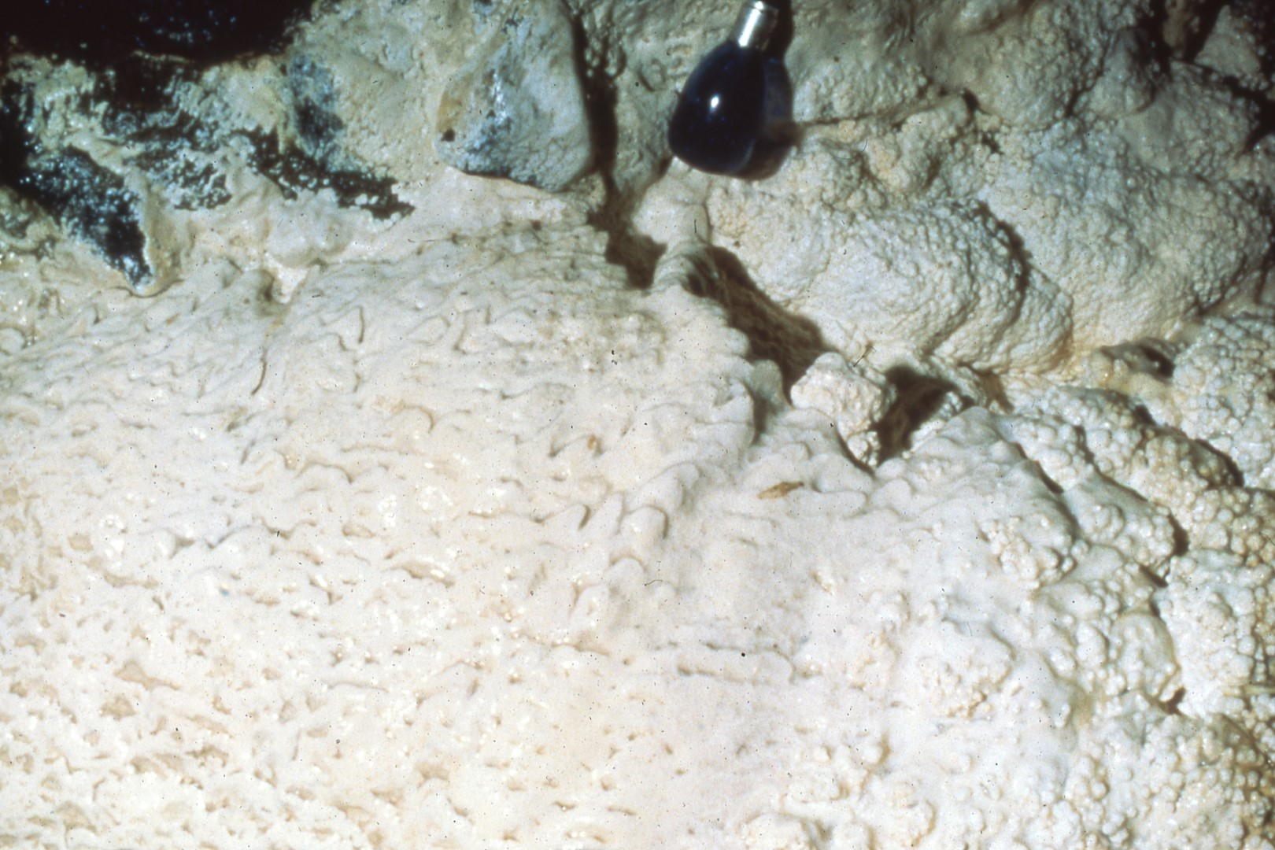
Notes:
In a nearby cave, it’s about 200 feet deep, in the back of it is a little flow. This is the first that we have found on the island.

Slide 50
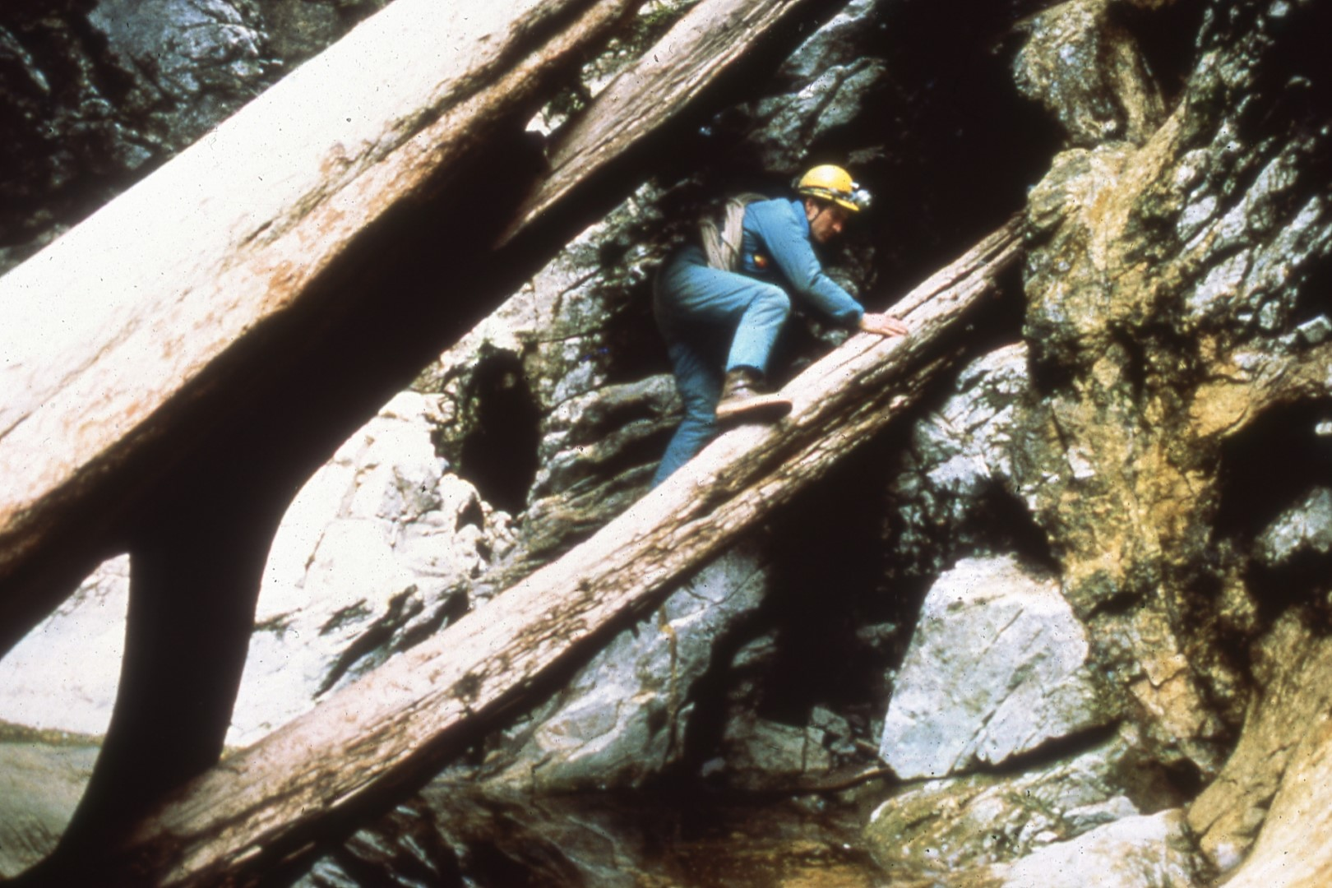
Notes:
This is Kevin going into Marble Cave, and I put this in to demonstrate the fact that we have a lot more caves on the island. We’ve found, as I said earlier, 30 caves since we started the recent investigations up there. Last winter a new geologist with the Ketchikan area of the Forest Service flew the island and was then working on getting some infrared photography flown of it. He flew over El Capitan Peak and found open holes in about 27 feet of snow in places where we didn’t even suspect there were pits of one sort or another. This spring, in about a three-week period of time, he started investigating some resurgences. He found seven new caves, two of them he claims are great big walk-in passages, much bigger than El Capitan. Until we can get up there and survey them, we don’t know whether he is exaggerating or whether, in fact, he has found something good. But we have a lot of potential.

Slide 51
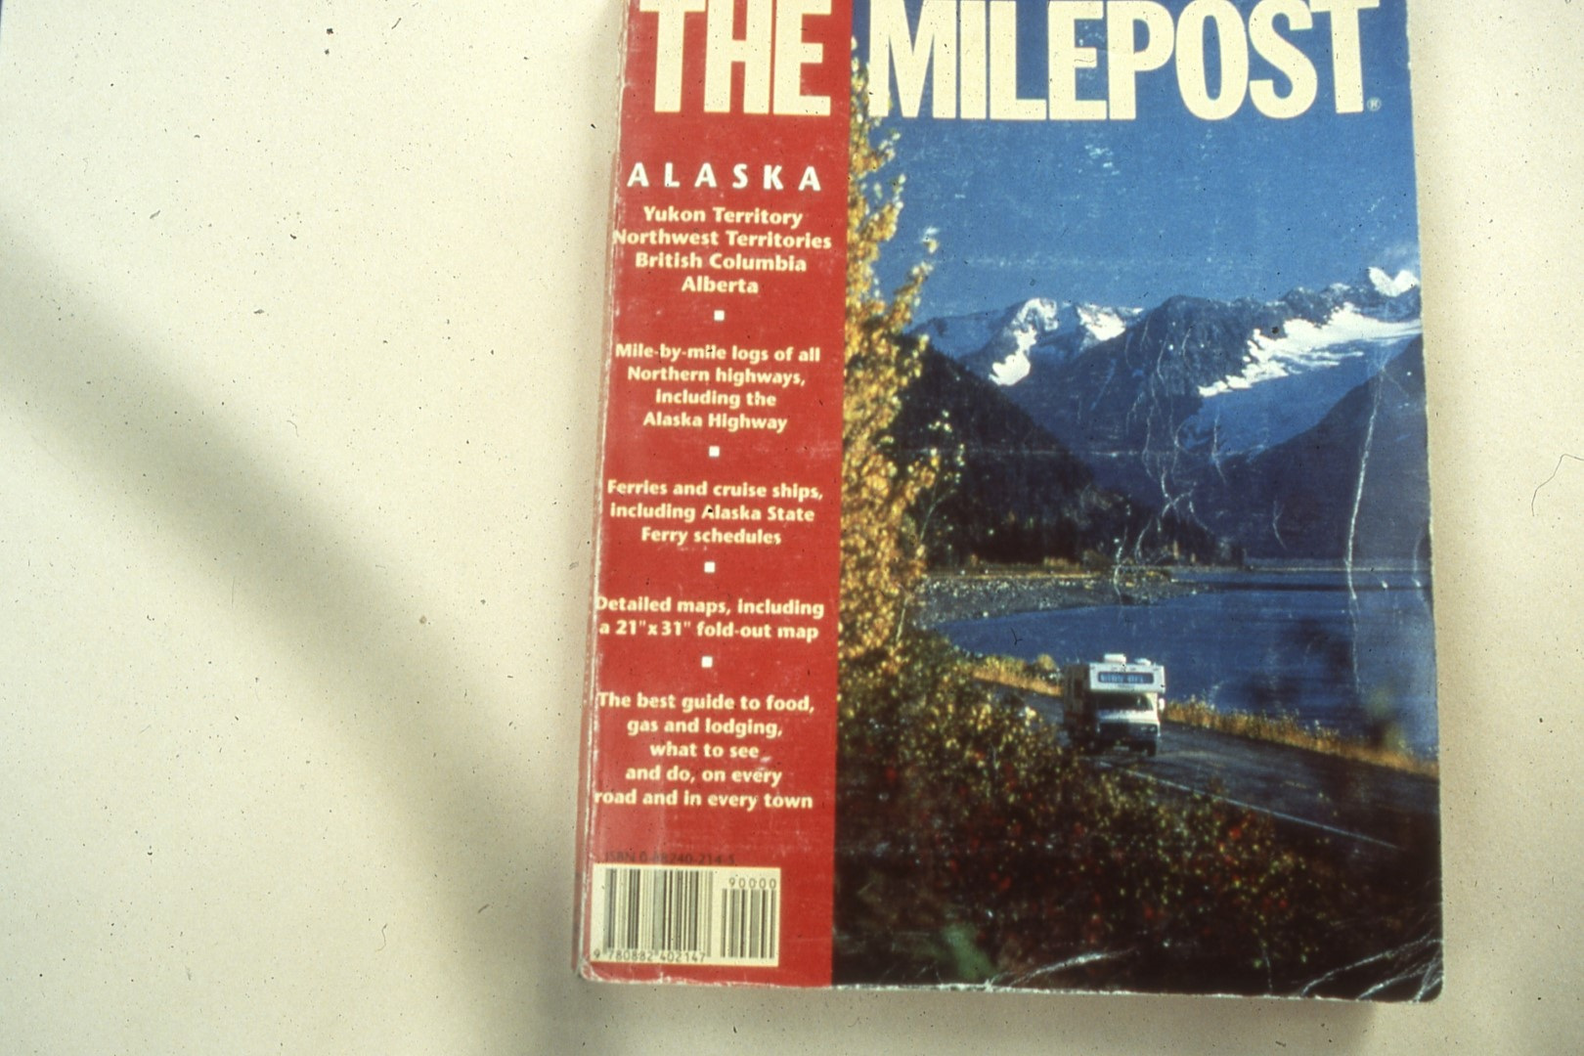
Notes:
Come up there. Plan on it being expensive. For my pickup truck, which you saw before, round-trip for myself, one person, is about $325-350, from Prince of Wales to Hollis and back. If you come from Seattle, you are almost going to have to double or triple that. You do need to know, if you are going to wander around the woods, you need to have good route-finding abilities, know your way around the woods, and be in fairly decent physical condition for the hiking to get to these caves. This is The Milepost.
This is The Milepost. It is a magazine put out by the Alaska Northwest Publishing Company. Its address is outside. It’s the guidebook to Alaska – how to get there, where to write, tells you all about the various towns, where to write for facilities, things of that sort. Found in many good libraries in their reference section, it’s in practically every library in the Pacific Northwest. Those of you near REI, they carry it, or could order it for you.

Slide 52
Slides By:
Carlene Allred
Kevin Allred
Harvey Bowers
Bob Bastasz
Dave Klinger
Steve Meyer
Notes:
Slides were provided by Carlene Allred, Kevin, Harvey Bowers, Bob Bastasz, Steve Meyer and myself and I thank them for the use of their slides.

Slide 53
Program By:
Dave Klinger
Produced By:
Paul Stevens
Original Music By:
John Manchester
Notes:
(No narration)

Slide 54
An NSS Audio-Visual Library Presentation
Prince of Wales Island Expedition
Original slide program S622
Slides digitized by David Caudle
Cassette narration transcribed by David Socky
PowerPoint program created by David Socky
54 slides, with script in presenter notes
PowerPoint created 9/2/2021
National Speleological Society
6001 Pulaski Pike
Huntsville, AL 35810-1122
256- 852-1300
nss@caves.org
https://caves.org/
Notes:
(No narration)

